Slide 1
Victory Over Trials
Wednesday Night Bible Class
Dan Fuller

Slide 2
Victory Over Trials
Lesson 6
The Nature Of God

Slide 3
Lesson 6 The Nature Of God From lesson 5
Tools We Can Use
Follow God’s word.
Don’t play with the devil.
Go to God in prayer.
Follow the principle of sowing/reaping.

Slide 4
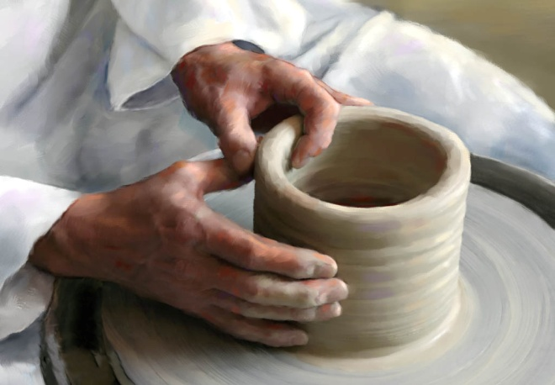
Lesson 6 The Nature Of God From lesson 5
The Clay/ Potter Principle
Isaiah 64:8 (Jeremiah 18: 1-8)
“But now, O Lord, You are our Father;
We are the clay, and You our potter;
And all we are the work of Your hand.”

Slide 5
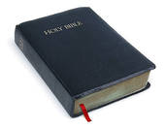
Lesson 6 The Nature Of God
God is…
Omniscient
Omnipotent
Omnipresent

Slide 6
Lesson 6 The Nature Of God From Lesson 1
“God just wants me to be happy”.
Be careful with this saying and thought.
It can be a dangerous concept…..
Sin
Divorce and separated families.
Selfishness
Look at Ecclesiastes 7:14

Slide 7
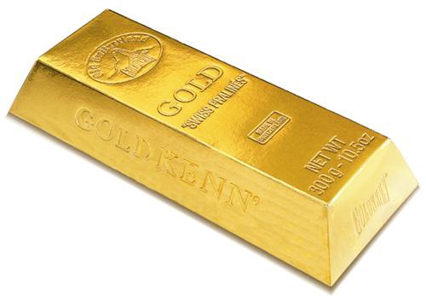
Lesson 6 The Nature Of God From Lesson 5
How does God look at our trials?
They are more precious than gold.
1 Peter 1:6-7

Slide 8
Lesson 6 The Nature Of God
Question of the night…
Is God fair?

Slide 9
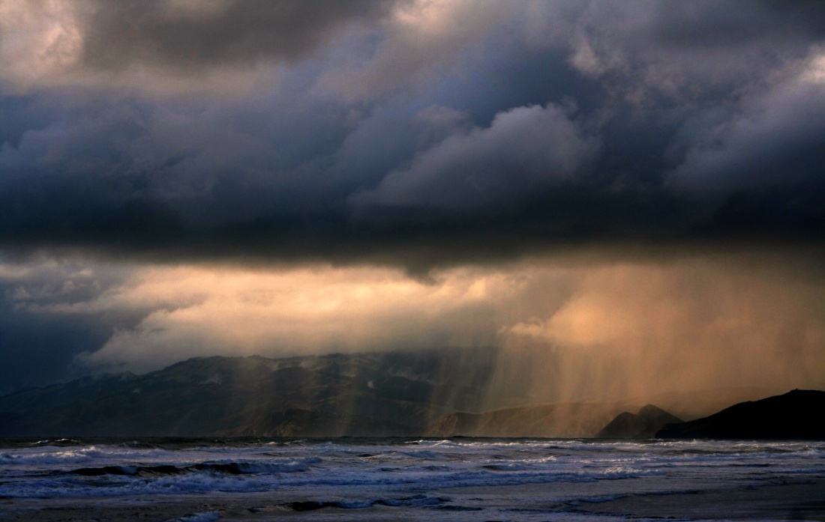
Lesson 6 The Nature Of God
Rain
“ … and sends rain on the just and on the unjust.” Matthew 5:45

Slide 10
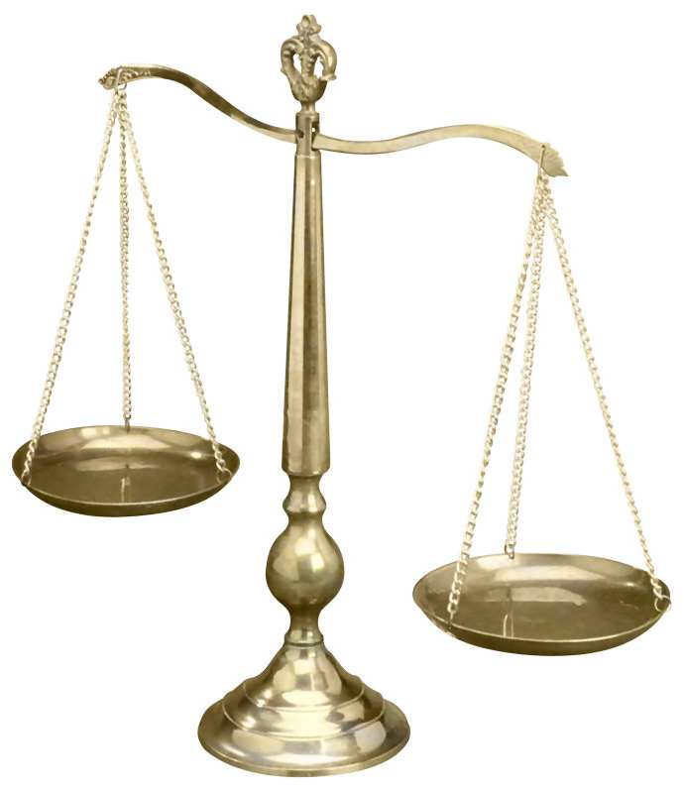
Lesson 6 The Nature Of God
Why do the wicked prosper?
Our sense of justice says the goodness
should be parented with comfort and
evil should be parented with discomfort.

Slide 11
Lesson 6 The Nature Of God
This bothered others….
Jeremiah - Jer. 12:1,2
Habakkuk - Hab. 1:13
Malachi - Mal. 3:13-15

Slide 12
Lesson 6 The Nature Of God
Why do the wicked prosper?
This really bothered Job.
12:6, 21:7, 24:2-25, 27:8-23

Slide 13
Lesson 6 The Nature Of God
What does it prosper?
Physical and Economic Laws
Demonstrates God’s mercy
Tests the faith of the righteous
Look at Psalm 37:1

Slide 14
Lesson 6 The Nature Of God
The wicked’s prosperity is fleeting.
Job 21:18
Psalm 37:2,13
Matthew 6:2,5,16

Slide 15
Lesson 6 The Nature Of God
The wicked will be judged.
Job 21:30, 27:20, 27:22
Psalm 73:18,19
Matthew 25:30,46

Slide 16
Lesson 6 The Nature Of God
Charging God Foolishly
Job didn’t do it…. Job 1:22
Some charge God because of…
Mass destruction
Man’s sins
Injustice
Physical handicaps

Slide 17
Lesson 6 The Nature Of God
God’s Expectations of Us
“Woe to you, scribes and Pharisees,
hypocrites”.
Read Matthew 23:23

Slide 18
Lesson 6 The Nature Of God
God’s Expectations of Us
God expects us to be just. Psalm 106:3, Isaiah 1:17
God expects us to be merciful. Matthew 5:7
God expects us to be faithful Rev. 2:10, 1 Cor. 4:1,2

Slide 19
Lesson 6 The Nature Of God
Assurances from God
We know we have eternal life. 1 John 5:13-20
We know He answers are prayers. 1 John 5:13
We know we can keep from sin. 1 John 5:18
We know we are not of the world. 1 John 5:19
We know that we are in Christ. 1 John 5:20

