Slide 1
Victory Over Trials
Wednesday Night Bible Class
Dan Fuller

Slide 2
Victory Over Trials
Lesson 5
The Nature Of Man

Slide 3
Lesson 5 The Nature Of Man
Tools We Can Use
Follow God’s word.
Don’t play with the devil.
Go to God in prayer.
Follow the principle of sowing/reaping.

Slide 4
Lesson 5 The Nature Of Man
The Principle of Sowing and Reaping
There has to be a consequence to sin.
Adam and Eve
David
Galatians 6:7-8

Slide 5
Lesson 5 The Nature Of Man
From lesson 4
We can be hit with …
Financial problems
Loss of loved ones
Physical problems & sickness
Disappointment

Slide 6
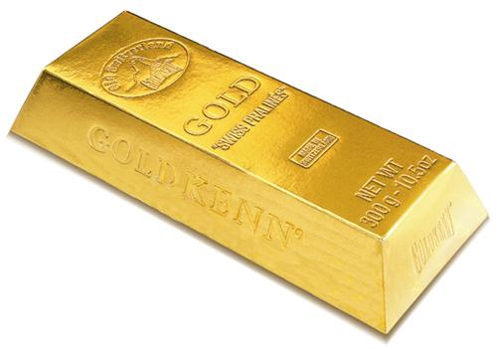
Lesson 5 The Nature Of Man
How does God look at our trials?
They are more precious than gold.
1 Peter 1:6-7

Slide 7
Lesson 5 The Nature Of Man
Do you believe this?
Ephesians 3:20
“ Now to Him who is able to do exceedingly abundantly above all that
we ask or think, according to the power
that works in us”.

Slide 8
Lesson 5 The Nature Of Man
Do you believe this?
Philippians 4:13
“ I can do all things through Christ
who strengthens me”.

Slide 9
Lesson 5 The Nature Of Man
From lesson 4
There will be storms in your life.
Job said he was going through a tempest.

Slide 10
Lesson 5 The Nature Of Man
From lesson 4
Jesus is waiting for us in every storm.
Turns darkness into light
Unchanging love
Helps us in our sorrows
Gives us hope
Quiets storms Psalm 107:29

Slide 11
Lesson 5 The Nature Of Man
We all have the ability to sin
against our God and others.
Romans 3:23
We all have the ability to escape
temptation.
1 Corinthians 10:13

Slide 12
Lesson 5 The Nature of Man
The storms within us.
Job had to deal with great anguish.
Look at other verses…
Psalm 61:2, 143:4
Isaiah 54:11-14

Slide 13
Lesson 5 The Nature of Man
Loneliness
Job – Job 23:3-9
Jesus – Matthew 27:46

Slide 14
Lesson 5 The Nature of Man
Grief that death brings
Job 6:2,3
1 Thessalonians 4:13-18
Misfortune can only take away that which
good fortune gave.

Slide 15
Lesson 5 The Nature of Man
Sleeplessness
Job – 7:4, 13, 14
Problems are always intensified at night.
Physical fatigue always accentuates our
problems.

Slide 16
Lesson 5 The Nature of Man
Our memories: Pain and Comfort
Job 29:2-25 …It is a gift from God.
But look again…. Job 30:1, 9, 10

Slide 17
Lesson 5 The Nature of Man
Disappointment in friends & loved ones.
Jesus – Judas
David – Absalom
Psalm 41:7-9
2 Samuel 18:33

Slide 18
Lesson 5 The Nature of Man
Feelings of worthlessness
It is a “feeling”
Job 7:7 – “ My life is wind”
Don’t judge the worth of your life.

Slide 19
Lesson 5 The Nature of Man
A Desire For Death
Job had it.. 3:21, 6:8-9, 7:15
Jeremiah – Jeremiah 20:14-18
Elijah – 1 Kings 19:4
God’s plan – 1 Corinthians 3:17

Slide 20
Lesson 5 The Nature of Man
Hopelessness vs. Hope
Job – 7:6,7
But there is hope. 2 Corinthians 4:16-17

