Slide 1
Victory Over Trials
Wednesday Night Bible Class
Dan Fuller

Slide 2
Victory Over Trials
Lesson 4
Storms

Slide 3
Lesson 4
Storms
From Lesson 3
Satan knows you and your family.
Satan has a grip on the world.
God puts limits on Satan’s power.
Satan is intelligent and crafty.

Slide 4
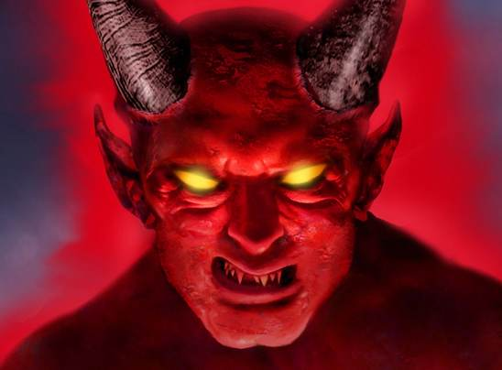
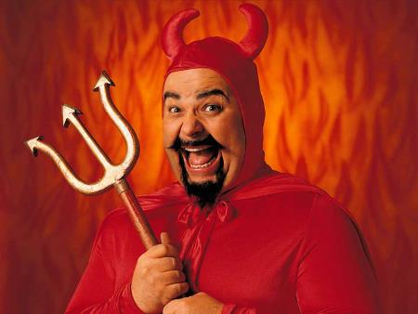
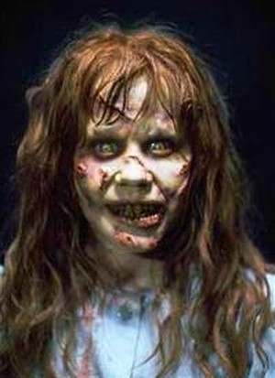
Lesson 4
Storms
From Lesson 3
Hollywood's Satan

Slide 5
Lesson 4
Storms
From Lesson 3
Satan is real.
Satan is intelligent.
Satan is crafty.
Satan is diligent.
Satan has a powerful personality.

Slide 6
Lesson 4
Storms
From Lesson 3
Tools that Satan Uses
1. I don’t exist. Don’t believe in me.
2. It doesn't matter what you believe in.
3. There’s no such thing as sin.
4. I have a better plan than God.

Slide 7
Lesson 4
Storms
From Lesson 3
Satan is ……..
The false accuser. Job 1:9-11, Rev. 12:10
The destroyer. Acts 20:28-30, James 3:16
The deceiver. Gen. 3:16, 2 Cor. 11:13-14
The tempter. 1 Thess. 3:5, 1 John 3:8

Slide 8

Lesson 4
Storms
From Lesson 3
You are at war !!!

Slide 9
Lesson 4
Storms
Tools We Can Use
Follow God’s word.
Don’t play with the devil.
Go to God in prayer.
Follow the principle of sowing/reaping

Slide 10
Lesson 4
Storms
From Lesson 3
“Resist the devil and he will flee
from you”.
James 4:7

Slide 11
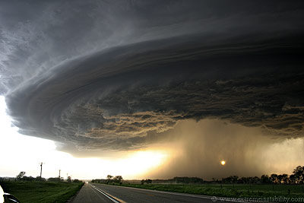
Lesson 4
Storms
There will be storms in your life.
Guaranteed

Slide 12
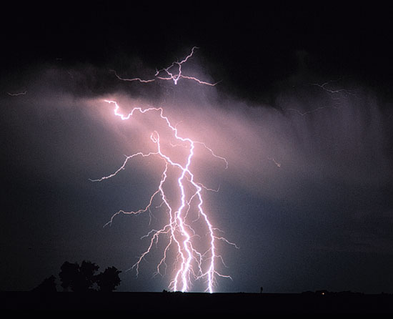
Lesson 4
Storms
Job considered what he was going through, a tempest.
Job 9:17

Slide 13
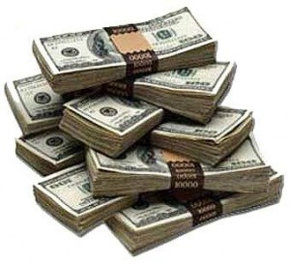
Lesson 4
Storms
Satan starts his work
First, material wealth.
Job 1:14-17 , 1 Tim. 6:7
For some, this is enough to start doubting
God.

Slide 14
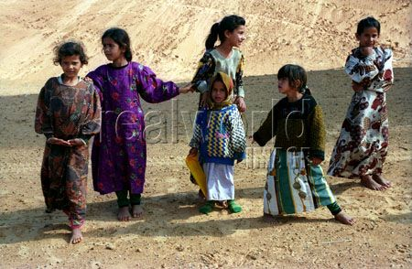
Lesson 4
Storms
Second Storm, Death
Job’s 10 children. Job 1:18,19

Slide 15
Lesson 4
Storms
Job is not silent about his misery
7:5 My flesh
19:20 My bone
30:17-18 My bones
30:30 My skin

Slide 16
Lesson 4
Storms
Job’s wife takes Satan’s side.
“Do you still hold fast to your
integrity? Curse God and die!”
Job 2:9
Temptation can come from even
the ones we love.

Slide 17
Lesson 4
Storms
Disappointment is a tool that
Satan can use.
Look at Job’s pain. 19:19
Encourage one another
1 Thessalonians 5:14

Slide 18

Lesson 4
Storms
Job’s friends made things worse.
11:6, 16:1-7, 19:2, 19:21, 22:5-9

Slide 19
Lesson 4
Storms
Job’s friends made things worse.
But were they right?
Job knew the seriousness of sin. 10:14,15
Job was ready to make amends. 10:2, 31:5,6
God’s view of Job. 1:1, 1:8, 2:3
They found out they were wrong. 42:7,8

Slide 20
Lesson 4
Storms
Is it a sin to falsely accuse someone?
“ He who justifies the wicked, and he who
condemns the just, Both of them alike are an
abomination to the Lord.”
Proverbs 17:15

Slide 21
Lesson 4
Storms
Some turn away when the wealth is gone.
Proverbs 14:20
Proverbs 19:4
John 6:26

Slide 22
Lesson 4
Storms
Some use shame and contempt.
Look at ….
12:4
19:18
30:9,10

Slide 23
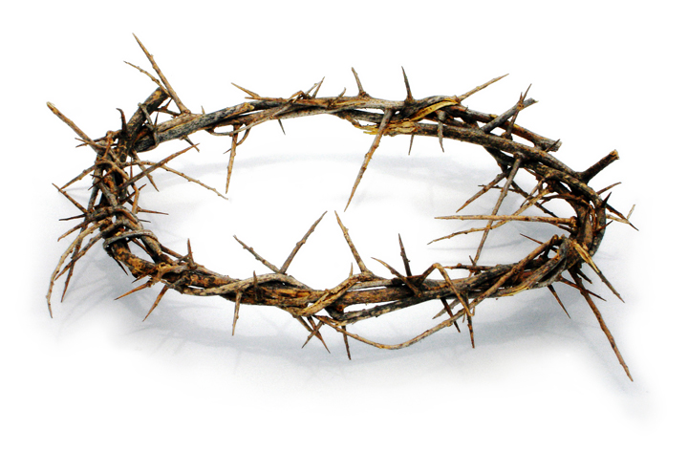
Lesson 4
Storms
Christ suffered shame
Matthew 26:67
Matthew 27:18
Hebrews 12:2

Slide 24
Lesson 4
Storms
Jesus is waiting for us in every storm.
Turns darkness into light. 2 Sam. 22:29
Unchanging love. Malachi 3:6
Helps us in our sorrows. Psalm 13:2
Gives us hope. Psalm 121:1-2
Quiets storms. Psalm 107:29

