Slide 1
Victory Over Trials
Wednesday Night Bible Class
Dan Fuller

Slide 2
Victory Over Trials
Lesson 3
Satan

Slide 3
Lesson 3
Satan
Every one has trials.
God knows our trials.
We all have the same God.
We all have the ability to experience
victories.
From Lesson 2

Slide 4
Lesson 3
Satan
The Principle of Sowing And Reaping
2 Corinthians 9:6 – sparingly, bountifully
Galatians 6:8 – corruption, eternal life
Galatians 6:7 – sowing, reaping
From Lesson 2

Slide 5
Lesson 3
Satan
2005 Harris Poll
75% believed in Heaven
72% believed that Jesus is the Son of God.
62% believed in Satan and Hell.

Slide 6
Lesson 3
Satan
Points to Consider
Satan is real.
Satan is intelligent.
Satan is crafty.
Satan is diligent.
Satan has a powerful personality.

Slide 7
Lesson 3
Satan
Satan in contrast
God is love. Satan is absent of love.
God is all powerful. Satan is restricted.
God is all knowing. Satan is limited.
God is everywhere. Satan is limited.
God can not lie. Satan is the father of lies.
God frees people. Satan binds people.

Slide 8

Lesson 3
Satan
Hollywood’s Satan

Slide 9
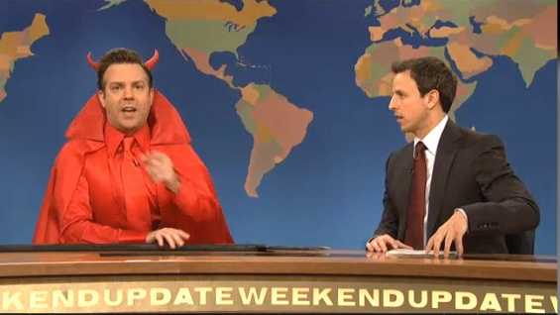
Lesson 3
Satan
Hollywood’s Satan

Slide 10
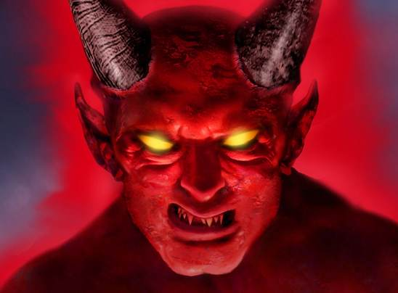
Lesson 3
Satan
Hollywood’s Satan

Slide 11
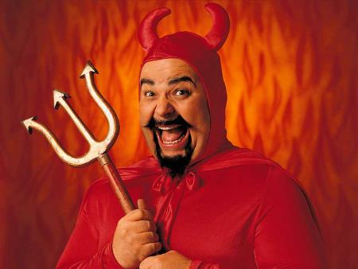
Lesson 3
Satan
Hollywood’s Satan

Slide 12
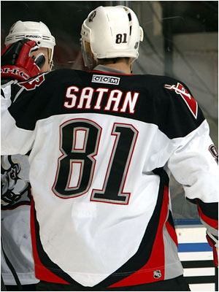
Lesson 3
Satan
Hockey’s Satan

Slide 13
Lesson 3
Satan
Satan’s Grasp on the World
2 Corinthians 4:4
In the media (internet)
In the religious world
In the hearts of men
In families
In the work place
In our schools
In popular science (evolution)

Slide 14
Lesson 3
Satan
Satan Knows You & Your Family
Satan knew Job. Job 1:9
Satan had a plan for Job.
Satan has a plan for you & your family.
God has a plan for you & your family.

Slide 15
Lesson 3
Satan
Satan Talks
With Eve - Genesis 3:1-5
With Christ - Matt. 4: 1-11
With God - Job 1:7-12 , 2:1-6

Slide 16

Lesson 3
Satan
You are at war !!!!

Slide 17

Lesson 3
Satan
You are at war !!!!
Ephesians 6:10-18
Romans 6:12
Psalm 144:1
1 Timothy 6:12
2 Timothy 4:18

Slide 18
Lesson 3
Satan
Satan is the False Accuser
Job – Job 1:9-11
Of men – Revelation 12:10

Slide 19
Lesson 3
Satan
Satan is the Destroyer
Persecution – 2 Tim. 3:12
False Doctrines – Acts 20: 28-30
Strife & Confusion - James 3:16

Slide 20
Lesson 3
Satan
Satan is the Deceiver
Makes sin look appealing - Gen. 3:6
Transforms himself - 2 Cor. 11:13-14,
1 Tim. 4:1, Rev. 2:9 & 3:9, Luke 8:12
Works through people - He used Sabeans , Chaldeans, Job’s wife,
and Job’s friends.

Slide 21
Lesson 3
Satan
Satan is the Tempter
He tempts and entices us.
1 Thess. 3:5
1 John 3:8
John 8:44

Slide 22
Lesson 3
Satan
Satan’s Power Has Limits
God Sets Limits
Job 1:12, 2:6 What Satan can do.
1 Cor. 10:13 Satan does not have to overcome.
Hebrews 2:14 Death will not win.
Hebrews 4:15 Sin does not have to win.
James 4:7,8 Satan will back off.
2 Peter 2:9 We can be delivered.

Slide 23
Lesson 3
Satan
Some More Verses to Equip Us:
Romans 8:28
Philippians 4:13
Psalm 18:32,37
Psalm 28:7

