Slide 1
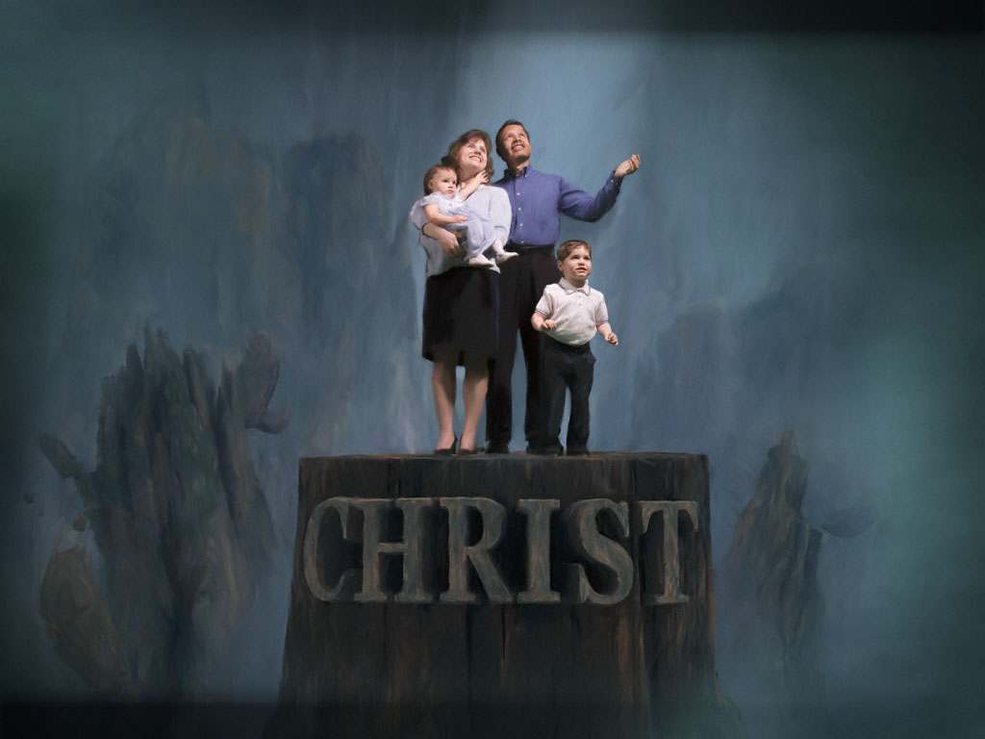
My Church Family
Lesson 11:
My Church Family’s Responsibility
Toward Its Young People

Slide 2
Responsibility
Toward Its Young People
3 things that influence the development of faith in a child
WHAT HAPPENS IN THE HOME
Parents are primary influence in teens’ lives (God’s design)
Deuteronomy 6:4-9 is a parent’s God-given duty
Children must see true Christianity lived out in front of them
WHAT HAPPENS IN THE CHURCH
The entire church (not just the youth program) has a tremendous influence on the development of faith
The Lord’s church must stay focused on its young people’s individual (not mass-produced) relationships with Christ
When young people graduate from high school, research shows they need 7 meaningful “connections” to the church (apart from the youth program) for them to remain faithful
WHAT HAPPENS IN THE CULTURE

Slide 3
Responsibility
Toward Its Young People
Goal of Church Family Toward Young People & Families
Equip them to work, serve & build up the church (Eph. 4:12)
Grow them to maturity in Christ (Eph. 4:13-16)
Present them perfect in Christ at the judgment (Col. 1:27-29)
The church family’s goal toward/for its young people goes beyond childhood, middle school, high school and teenage years at the home congregation.
Where will that young person be 10 years from now? 25? 50?
Active in the body of Christ?
A mature, faithful, serving, leading, teaching child of God?
We must look beyond the immediate and aim for the future…for eternity.
Graduating from high school and the youth group must not mean graduating from God and His church!

Slide 4
Responsibility
Toward Its Young People
Working Together As a Family for the Good of Families
Equip Parents
With knowledge to provide for Christian nurture of children
With heart to set their family & Christian family as a priority
With tools to communicate the Christian faith to children
With practical ways to develop spirituality in the home and to give their child a spiritual self identity—“I belong to God”
Expect Parents to Be Involved in Lives of Their Children
Expect parents to develop spirituality in the home
Expect parents to set worship & Bible classes as a priority
Expect parent involvement in the “Family/Youth Program”
“If you have a youth in church, you’re in Youth Ministry!”
Get involved in spiritual and physical aspects of program
If a congregation continually isolates teens in all they do in the church, they will isolate them right out the door!

Slide 5
Responsibility
Toward Its Young People
Working Together As a Family for the Good of Families
Equip the Extended Family (the church)
With the sense of actually being a family (cf. Mark 3:31-35)
With motivation to provide ongoing nurture for children
With invitations to participate in “youth activities”
Expect the Extended Family to Be Involved in Lives of Children
“If you’re interested in spiritual development of children in church, you’re in Youth Ministry!”
Children need various age groups involved in their lives
Adults with kids at home, kids out of home, or no kids
Need five different intergenerational relationships: with senior citizens (married/single), middle-aged (married/single), young adult (married/single), college student, etc.

Slide 6
Responsibility
Toward Its Young People
Working Together As a Family for the Good of Families
To grow into mature Christian adults, young people need their 2 formative families (at home & in the church) to work together.
They need repeated opportunities to observe, dialogue and collaborate with mature Christian adults, to build lasting and meaningful relationships.
Teens from broken homes need opportunities to be with adults and couples of healthy marriages and homes.
Young people will imitate the values which surround them.
The real power for faith formation is not in a youth program but in the families and the extended family of the church.

Slide 7
Responsibility
Toward Its Young People
Working Together As a Family for the Good of Families
Roles for everyone in a Family/Youth Program
LEADERSHIP Roles
Adults (esp. parents) who have certain amount of “ownership” and empowered to take charge of events
VOLUNTEER Roles
Adults (parents and select adults from the congregation) who sign-up to help coordinate various activities
PERIODIC Roles
Adults who fill specific but limited needs, like hosting events in home, making reservations for trips, etc.
ENCOURAGEMENT/MENTORING Roles
Greet one another…Be hospitable to one another
Bear one another’s burdens…Edify…Pray for one another

Slide 8
Responsibility
Toward Its Young People
Working Together As a Family for the Good of Families
Give every youth a real & clear sense of belonging in the church!
Young people have a better opportunity to grow toward mature Christian adults when connected to the body of Christ, rather than being isolated from it!
Work to provide all teenagers with opportunities to serve and minister in the church, working alongside an adult in the church, training them to develop as leaders and teachers
If they do not BELONG NOW in the church, it won’t BE LONG until they’re NOT in the church!
Church
Family
Youth

