Slide 1
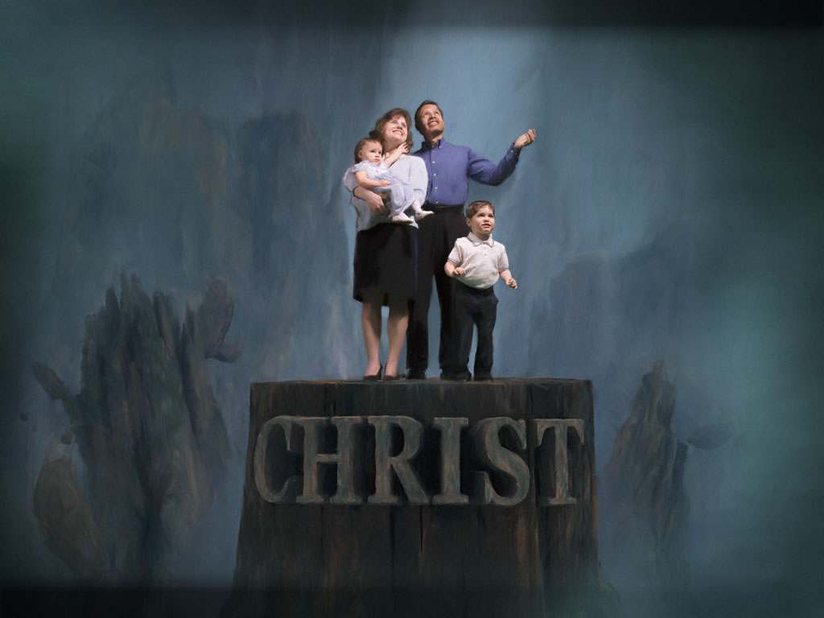
My Church Family
Lesson 10:
My Church Family’s Responsibility
Toward Its Young People

Slide 2
Responsibility
Toward Its Young People
3 things that influence the development of faith in a child
WHAT HAPPENS IN THE HOME
Parents are the primary influence in teens’ lives
Unfortunately, too many are not doing our jobs adequately
The tremendous power of parents’ influence on their children is part of God’s design
Deuteronomy 6:4-9 is a parent’s God-given duty. This is not so much about teaching/talking as it is about living, as it is about spending time with our families and “doing ministry” with our families. Youth ministries can assist parents in their roles, but they can’t replace those roles.
Children must see true Christianity lived out in front of them
Children will look as much like Jesus as their parents and fellow church members do.

Slide 3
Responsibility
Toward Its Young People
3 things that influence the development of faith in a child
WHAT HAPPENS IN THE CHURCH
The entire church (not just the youth program) has a tremendous influence on the development of faith
In the lives of its young people, the church cannot (and must not try to) compete with:
Academics, athletics or any other organization…
Community churches, denominational churches, or parachurch organizations…

Slide 4
Responsibility
Toward Its Young People
3 things that influence the development of faith in a child
WHAT HAPPENS IN THE CHURCH
The Lord’s church must stay focused on its young people’s individual (not mass-produced) relationships with Christ
In the grand scheme, youth ministries, in and of themselves, have limited power to produce long lasting change in young people’s lives.
Youth programs need to be used as tools to equip parents to teach, train and target (on heaven) their own children
Youth programs need to facilitate meaningful intergenerational interactions, “connections” and relationships of young people with mature Christian adults, from whom they can learn about Christian values, growth and maturity

Slide 5
Responsibility
Toward Its Young People
3 things that influence the development of faith in a child
WHAT HAPPENS IN THE CHURCH
The Lord’s church must stay focused on its young people’s individual (not mass-produced) relationships with Christ
In the grand scheme, youth ministries, in and of themselves, have limited power to produce long lasting change in young people’s lives.
The entire church (not just the youth program) has a tremendous influence on the development of faith
When young people graduate from high school, research shows that they need seven meaningful “connections” to the church (apart from the youth program) for them to remain faithful in their Christian worship and service to God

Slide 6
Responsibility
Toward Its Young People
Goal of Church Family Toward Young People & Families
Equip them (Eph. 4:12)
The Process
Put proper equipment in their hands
Show them how to use it (qualify them for its use)
The Purpose (both individually & collectively focused)
To equip for the work of service/ministry
To equip for the building up of the body of Christ

Slide 7
Responsibility
Toward Its Young People
Goal of Church Family Toward Young People & Families
Grow them (Eph. 4:13)
The Process
Teaching the knowledge of Christ (v. 13)
Speaking the truth (v. 15)
The Purpose
To grow to a mature Christian adult
To grow to the measure of the stature of fullness of Christ
To grow to no longer be a child (v. 14)
To grow up in all things into Christ (v. 15)
To grow to a sense of belonging in the body of Christ (v. 16)

Slide 8
Responsibility
Toward Its Young People
Goal of Church Family Toward Young People & Families
Present them (Col. 1:27-29)
The Process
Preach Christ (v. 28)
Warn every person with all wisdom (v. 28)
Teach every person with all wisdom (v. 28)
Labor and toil strenuously to this end (v. 29)
The Purpose
To ensure Christ is in each of them (v. 27)
To ensure each of them is in Christ (v. 28)
To present each of them perfect at judgment (v. 28)

Slide 9
Responsibility
Toward Its Young People
The church family’s goal toward/for its young people goes beyond childhood, middle school, high school and teenage years at the home congregation.
Where will that young person be 10 years from now? 25? 50?
Will he/she be active in the body of Christ?
Will he/she be a mature, faithful, serving, leading, teaching child of God?
We must look beyond the immediate and aim for the future…for eternity.

