Slide 1
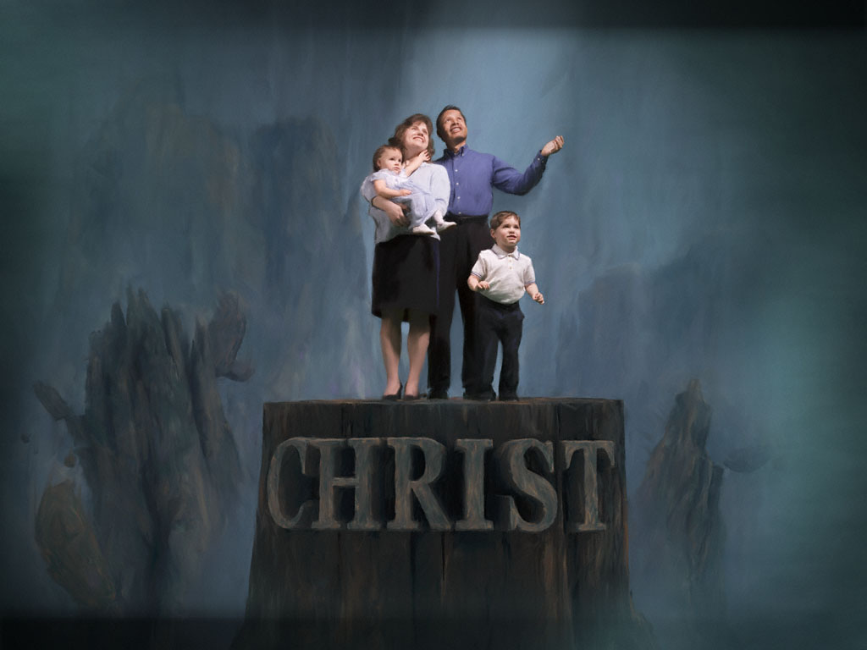
My Church Family
Lesson 8:
My Church Family’s Responsibility
Toward Its Young People

Slide 2
Responsibility
Toward Its Young People
Challenging Dangers of Today’s Culture
Our culture is constantly pulling at our youth
Pulling them into self-indulgent, peer-centered isolation
Pulling them away from parents & mature Christian adults
Our culture is constantly villainizing parents
Convincing kids their parents are “against them”
Our culture is playing a powerful role (perhaps the most powerful role) in the formation of young people’s values
Helping young people determine right vs. wrong
Our culture does not and is not encouraging “critical thinking”
The unbiased collection of data from various sources and drawing only such conclusions demanded by the evidence
Our culture does/is not helping teens grow into mature adults

