Slide 1
The Supreme Glory & Preeminence of Christ

Slide 2
Written by Paul about 60-62 A.D.
After Paul from Epaphras about false teachers
During his first Roman imprisonment (Acts 28:30)
Along with Philemon, Ephesians & Philippians
Colossians, Philemon & Ephesians carried by Tychicus & Onesimus
Ephesians & Colossians – “The Twin Epistles”
Ephesians: Emphasizes the Church as the Body of Christ (Eph. 1:22-23)
Colossians: Emphasizes Christ as the Head of the Church (Col. 1:18)

Slide 3
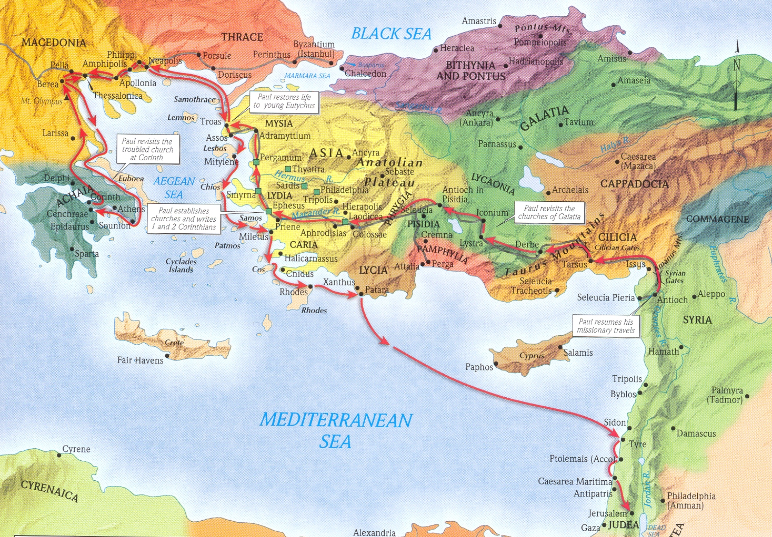

Slide 6
False teaching contained elements of:
Judaistic tendencies:
circumcision, the law, and special seasons
insisted on strict observance of certain Jewish requirements
Greek philosophy tendencies:
sort of “higher thought” cult, parading as “philosophy” (2:8)
put forth high-sounding phrases of an assumed superiority
Incipient Gnosticism tendencies:
seen in the theory that matter is essentially evil and that matter is the source of evil
claims for its devotees superior knowledge in matters beyond the range of mere human observation

Slide 7
From these premises, the false teachers concluded:
God and matter must be antagonistic to one another.
If matter is evil, God could not have created or governed the world.
They concluded that God must have used intermediate beings to create and serve the world (led to the worship of angels).
Two extremes for the treatment of the body resulted:
If the body is evil, it must be denied its natural desires (spiritual growth can come only by complete separation from all matter).
The counter view was that the soul was not affected by what the body did. Since the body is material and evil, none of its deeds are to be spiritually accounted for.
All flesh is evil, thus Christ could not have become man—deity would not have touched sinful flesh. He did not live in a human body, but appeared in a spirit form, who only seemed to be a human being.
These false theories limited the greatness and authority of Jesus Christ and the sufficiency of redemption in Him (1:15; 2:9-10).

