Slide 1
Lesson 6:
Their Philosophy for Evangelism & Worship

Slide 2
What This Class Is NOT Intended to Do
Not to be unkind
Not to present a haughty, un-Christlike spirit
Not to attack Community Churches (in general)
Not to attack a particular Community Church
Not to treat them unjustly in any way
Not to misrepresent them in any way
Not to ridicule or belittle any person or organization
Not to say, “We’re so much better than you”

Slide 3
What This Class Is Intended to Do
To follow the soul-saving instructions of the Lord:
“Beloved, do not believe every spirit, but test the spirits, whether they are of God…” (1 John 4:1; cf. 1 Thess. 5:21)
To follow the highly-praised example of the Bereans:
“…They received the word with all readiness, and searched the Scriptures daily to find out whether these things were so” (Acts 17:11).
To fairly examine the teachings of a popular religious movement in light of the teachings of Scripture, by presenting their teachings in their own words and comparing them with God’s teachings in His own Words
Psa. 119:105, 130; John 3:19-21; 2 Cor. 4:4-6; Eph. 5:13; 2 Pet. 1:19
To examine whether we are in “the faith”/“the truth” (2 Cor. 13:5-7), as there is only “one faith” (Eph. 4:4-6)
To sharpen our knowledge, inform our hearts and fortify our faith in the faith of the gospel (2 Pet. 3:15; Jude 3; Prov. 3:5-6)

Slide 4
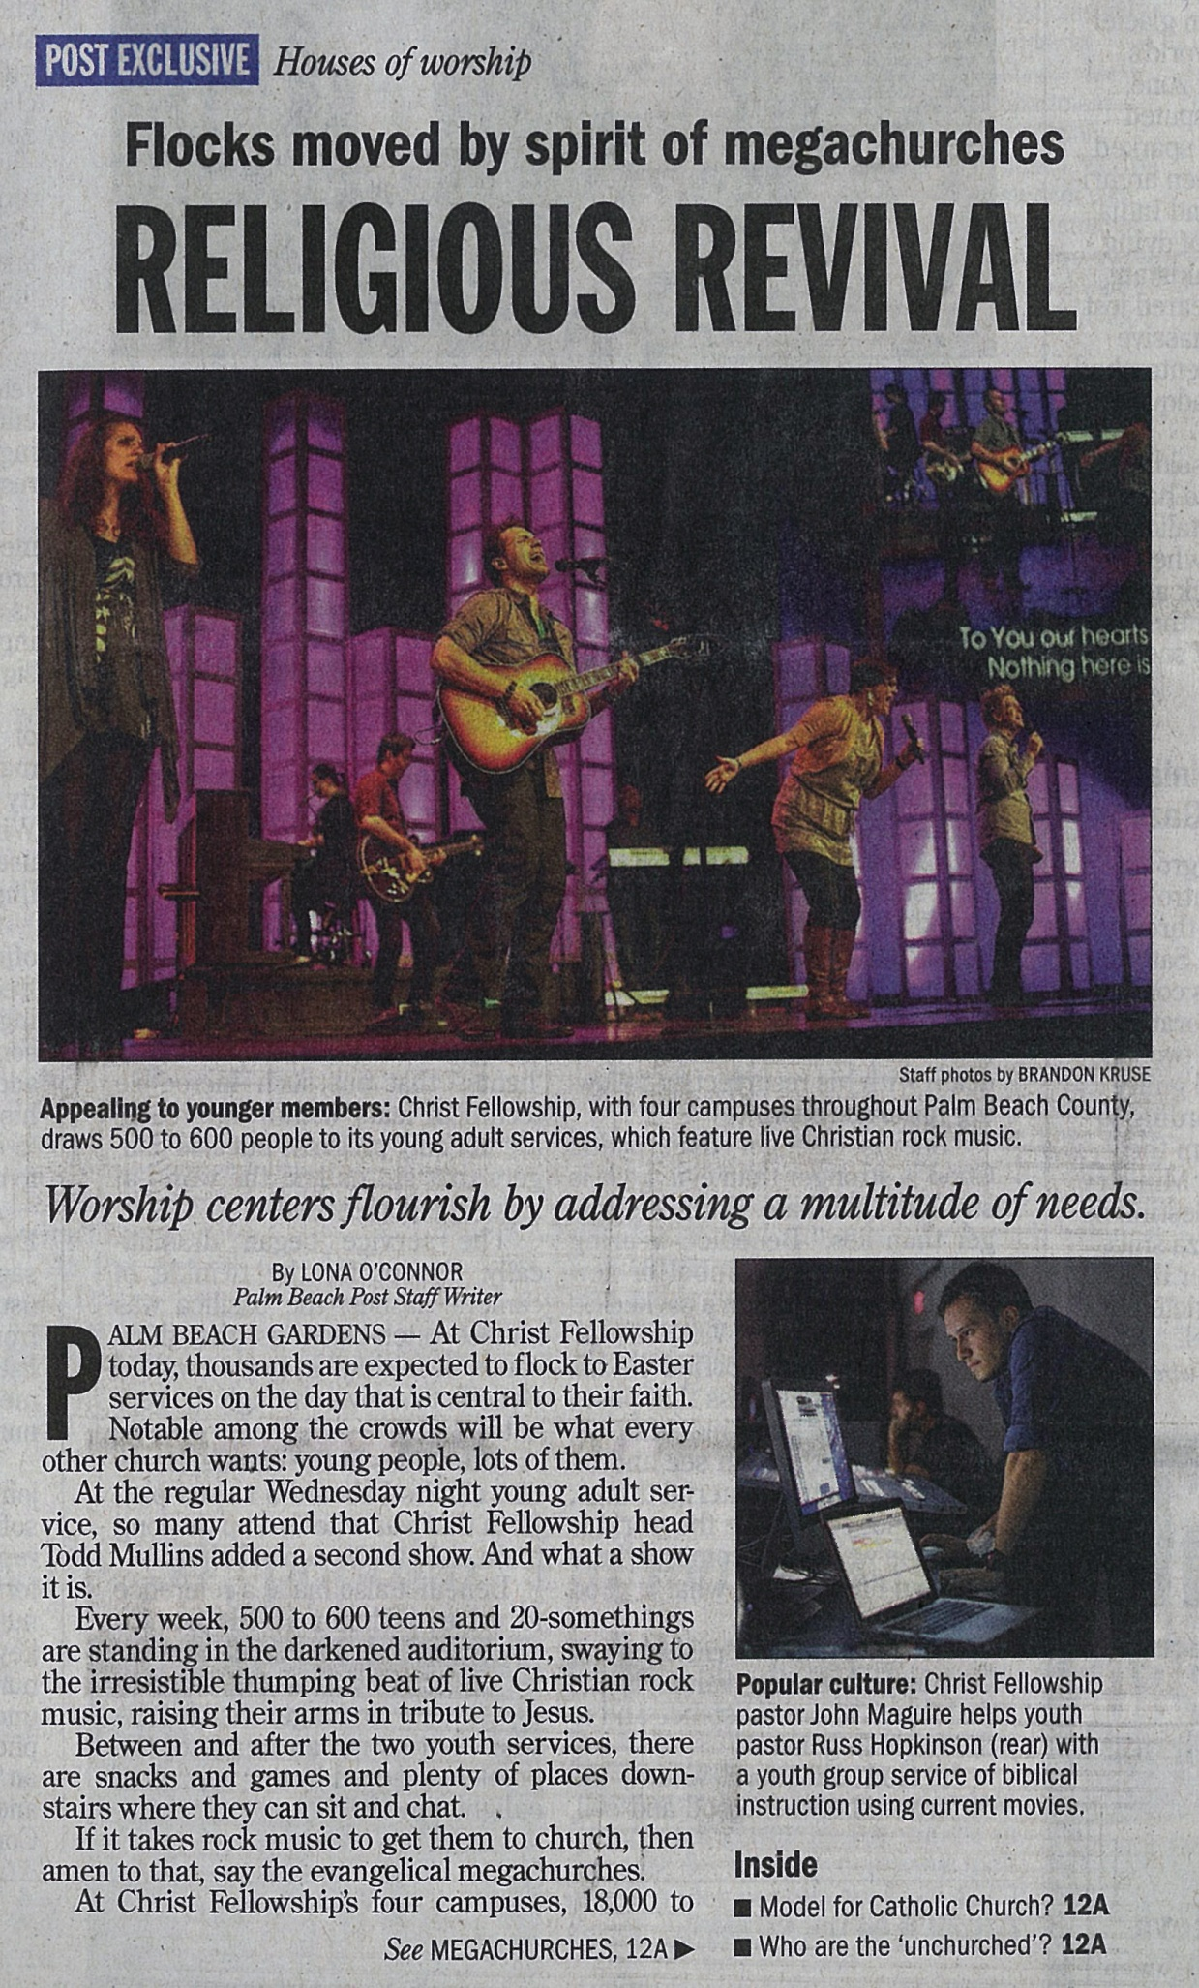
Their Philosophy
Palm Beach Post
April 8, 2012 – pp. 1A, 12A

Slide 5
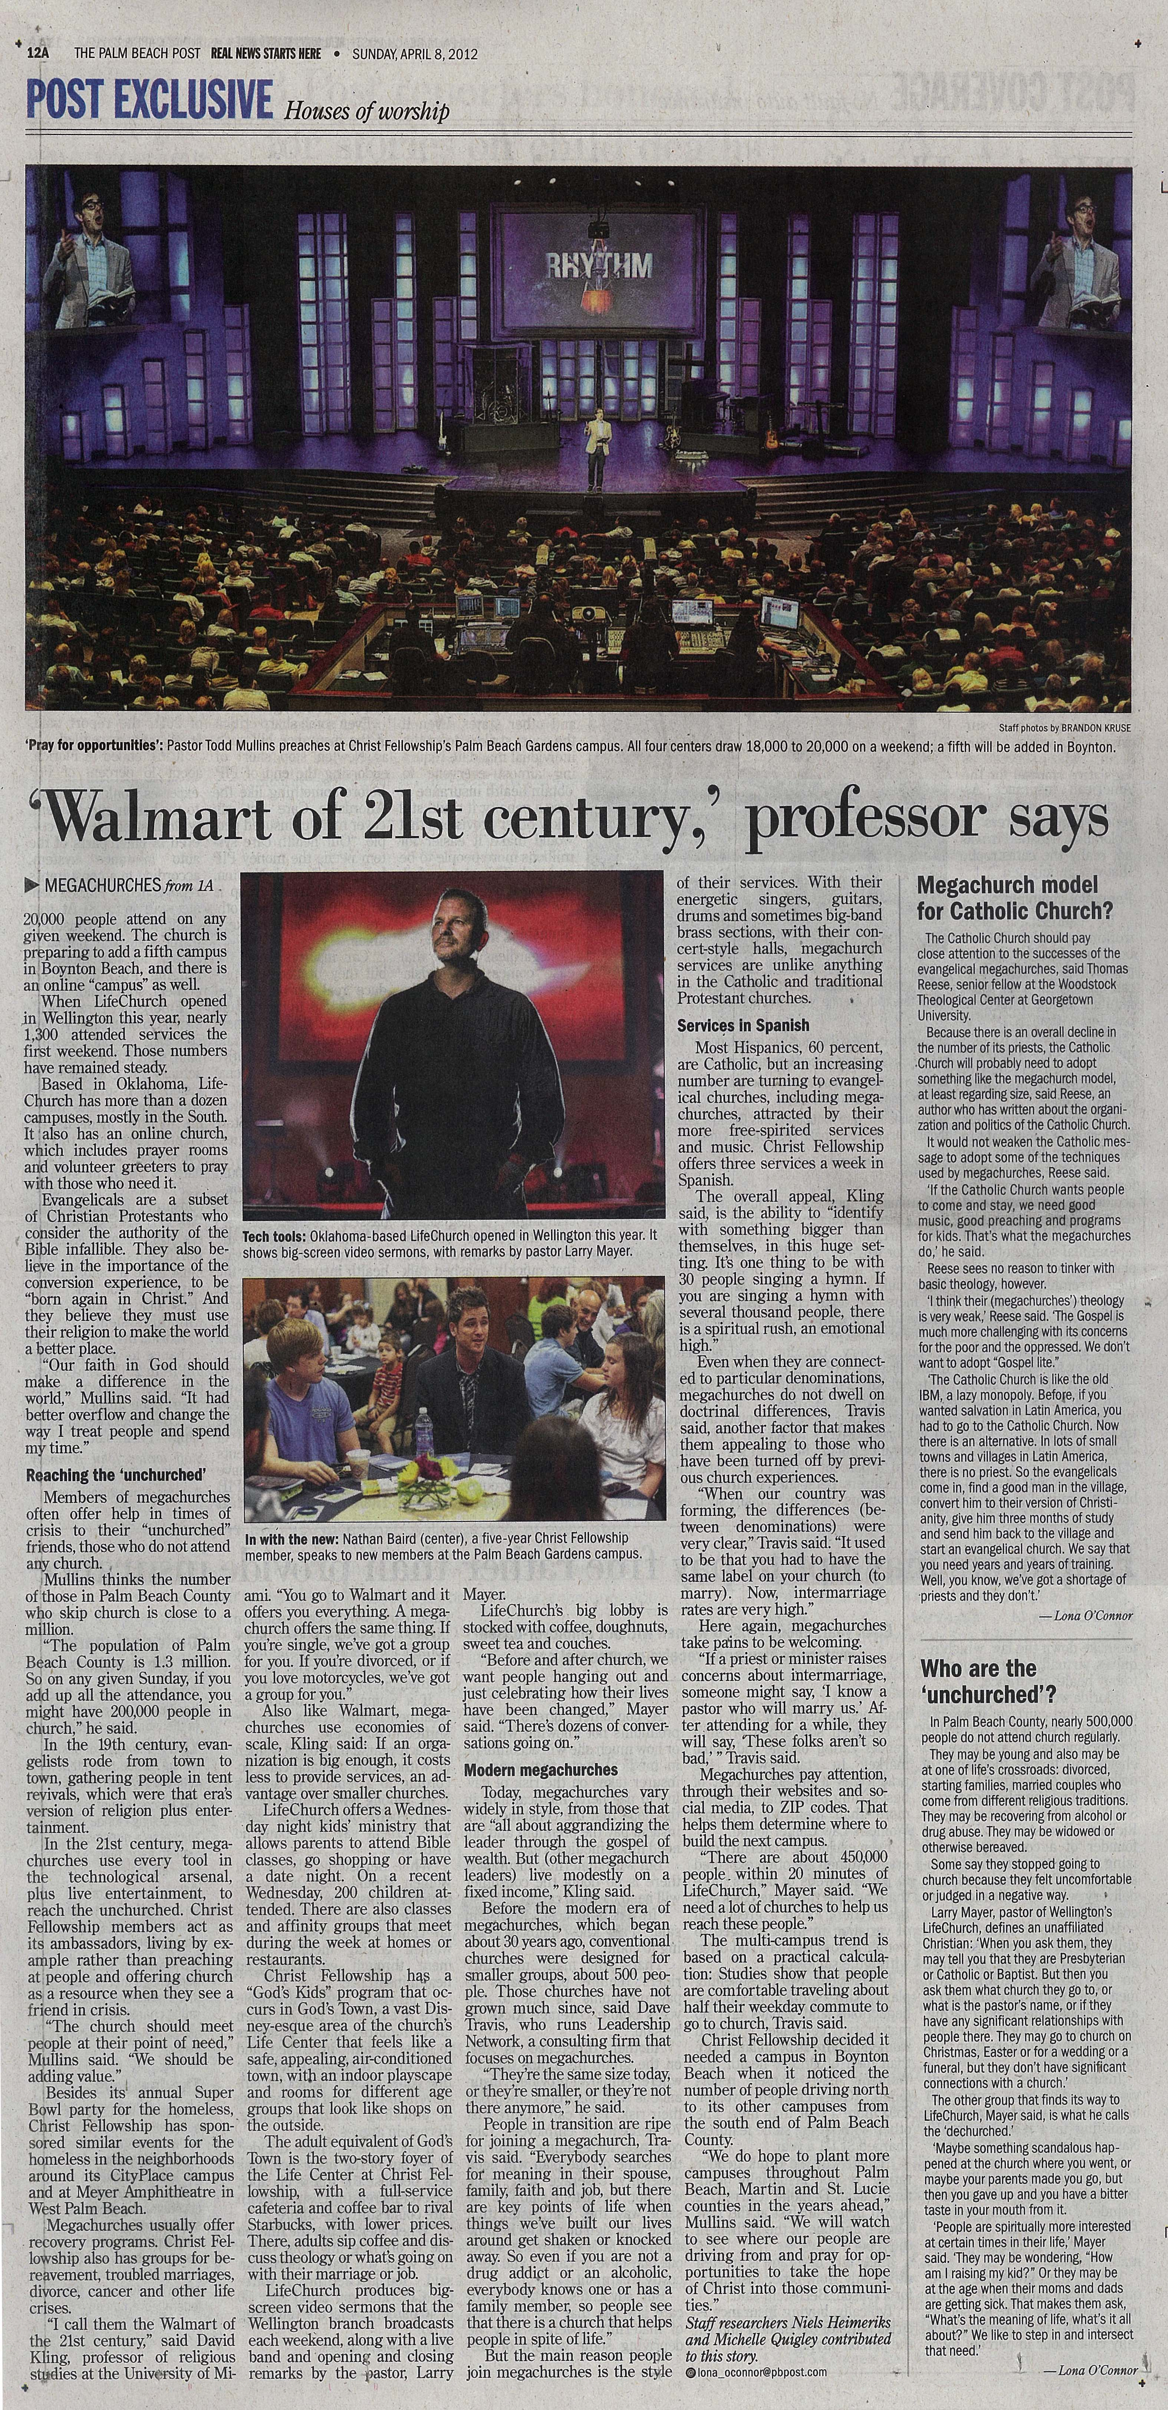
Their Philosophy
PB Post
4/8/12
p. 12A

Slide 6
Their Philosophy according to the “Textbook”

Slide 7
Their Philosophy according to the “Textbook”
From Chapter 9: “Who Is Your Target?”
“For your church to be most effective in evangelism you must decide on a target…While your church may never be able to reach everyone, it is especially suited to reaching certain types of people. Knowing who you’re trying to reach makes evangelism much easier.” (p. 157)

Slide 8
Their Philosophy according to the “Textbook”
From Chapter 9: “Who Is Your Target?”
“Personalize Your Target”
“Create a composite profile of the typical unchurched person your church wants to reach…make it easier for members of your church to understand who your target is…At Saddleback, we’ve named our composite profile ‘Saddleback Sam.’ Most of our members would have no problem describing Sam. We discuss him in detail in every membership class.” (p. 169)

Slide 9
Their Philosophy according to the “Textbook”
From Chapter 9: “Who Is Your Target?”
“Personalize Your Target”
“Saddleback Sam is the typical unchurched man who lives in our area. His age is late thirties or early forties. He has a college degree and may have an advanced degree…He is married to Saddleback Samantha, and they have two kids, Steve and Sally. Surveys show that Sam likes his job, he likes where he lives, and he thinks he's enjoying life more now than he was five years ago. He's self-satisfied, even smug, about his station in life. He's either a professional, a manager, or a successful entrepreneur. Sam is among the most affluent of Americans, but he carries a lot of debt, especially due to the price of his home.” (p. 169)

Slide 10
Their Philosophy according to the “Textbook”
From Chapter 9: “Who Is Your Target?”
“Personalize Your Target”
“Health and fitness are high priorities for Sam and his family. You can usually see Sam jogging each morning, and Samantha attends an aerobics class three times a week at the Family Fitness Center. Both of them like to listen to contemporary pop and country music, especially when they are working out… Another important characteristic of Sam’s is that he's skeptical of what he calls ‘organized’ religion. He's likely to say, 'I believe in Jesus. I just don't like organized religion.’ We like to counter this by joking, ‘Then you will like Saddleback. We’re disorganized religion!’” (p. 169-171)

Slide 11
Their Philosophy according to the “Textbook”
From Chapter 9: “Who Is Your Target?”
“Personalize Your Target”
“Saddleback Sam is also overextended in time and money. His credit card is used to the limit. He is very materialistic, and yet will honestly admit that his wealth has not brought him lasting happiness.” (p. 171)

Slide 12
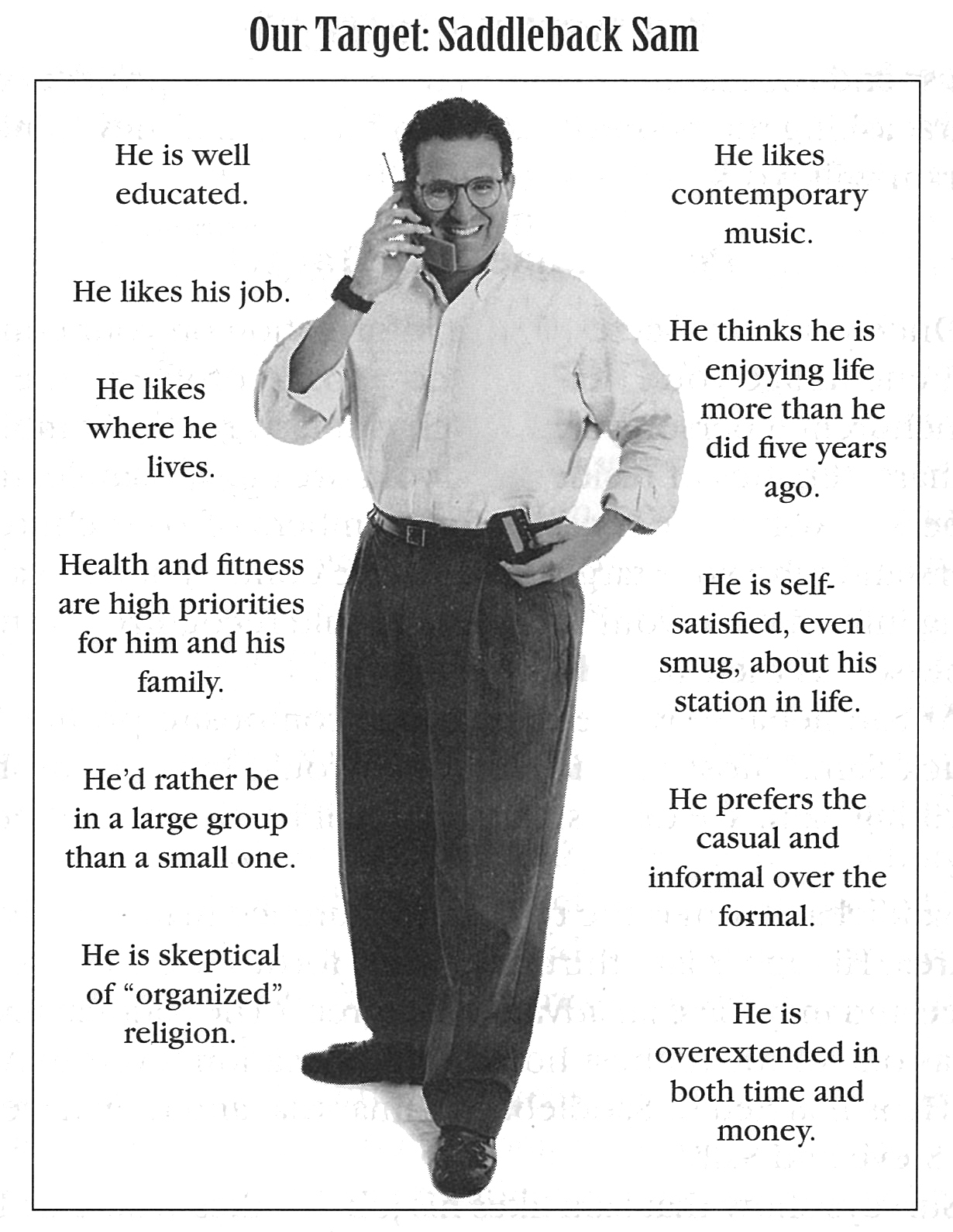
Their Philosophy according to the “Textbook”
(p. 170)

Slide 13
Their Philosophy according to the “Textbook”
From Chapter 11: “Developing Your Strategy”
“Catch Fish on Their Terms”
“Understanding and adapting to their culture”
“Letting your target determine your approach”
“Beginning with the felt needs of the unchurched”

Slide 14
The Teachings of Scripture on Evangelism
The purpose of the Lord’s Church
Matthew 28:19-20
Make disciples of all people; teach them all things
Ephesians 3:10-11
Make known the wisdom of God
Colossians 1:28
Warn every man, teach every man, to present every man
James 2:1-13
Show absolutely no partiality or favoritism
Let’s ask THE LORD who our “target” is!
Who are we to define, limit or “improve” that?

Slide 15
Their Philosophy according to the “Textbook”
From Chapter 11: “Developing Your Strategy”
“Use More Than One Hook”
“People in America are offered more options than ever before…more stations on my television…There used to be one kind of Coke; now there is Diet Coke, Cherry Coke, Classic Coke, Diet Cherry Coke, Caffeine-Free Diet Coke…”
It is “estimated that each week about 200 new grocery items enter the market, and each year nearly 300 new magazines are published. The Levi corporation alone has 70,000 products of different sizes, shapes, types and materials. We live in a world of multiple choices.”
“These changes have produced a generation that expects to be offered options in every area. Unfortunately, when it comes to worship services most churches offer only two options: Take it or leave it!” (p. 200)

Slide 16
Their Philosophy according to the “Textbook”
From Chapter 11: “Developing Your Strategy”
“Use More Than One Hook”
“It is not pandering to consumerism to offer multiple services or multiple styles of worship. It is strategic and unselfish, and it says we will do whatever it takes to reach more people for Christ. The goal is not to make it as difficult as possible but to make it as easy as possible for the unchurched to hear about Christ.” (p. 200)

Slide 17
Their Philosophy according to the “Textbook”
From Part 4: “Bringing in a Crowd”
“There is no correct ‘style’ of worship…I don’t think God is offended or even bothered by different styles of worship…In fact, I’m certain that God enjoys the variety! Remember, it was his idea to make us all different.” (p. 240)
“The style of worship that you feel comfortable with says far more about your cultural background than it does about your theology…” (p. 240-241)
“Every church likes to believe its worship style is the most biblical. The truth is, there isn’t a biblical style of worship. Each Sunday true believers around the world give glory to Jesus Christ using a thousand equally valid expressions and styles.” (p. 241)

Slide 18
Their Philosophy
Actual Screenshot on November 9, 2010 from
http://gochristfellowship.com/grow-deep/spiritual-questions/church/why-are-there-so-many-different-churches-and-denominations/

Slide 19
Their Philosophy
“In one sense, the diversity within the Christian community is something to be respected. God does not make cookie cutter Christians. Styles of worship vary from church to church, which simply illustrates the diversity that exists. What is most important is that God does not prescribe the form of our worship. Jesus taught that we should worship God ‘in the Spirit and in truth.’ (John 4:24)”
http://gochristfellowship.com/grow-deep/spiritual-questions/church/why-are-there-so-many-different-churches-and-denominations/ (Nov. 9, 2010)

Slide 20
The Teachings of Scripture on Worship
The purpose of worship
Not to:
“offer options”
“choose our own style”
To honor and worship GOD!
1 Chronicles 16:28-29
Matthew 4:10; Revelation 22:9
John 4:23-24
God most certainly did prescribe the form of worship!
Ask Cain & Abel – Genesis 4:3-5; Hebrews 11:4
Ask Nadab & Abihu – Leviticus 10:1-3
Ask King Saul – 1 Samuel 13:8-14
Ask King Uzziah – 2 Chronicles 26:16-21

Slide 21
Their Philosophy according to the “Textbook”
From Chapter 15: “Selecting Your Music”
“I’m often asked what I would do differently if I could start Saddleback over. My answer is this: From the first day of the new church I’d put more energy and money into a first-class music ministry that matched our target.” (p. 279)
“Today, MTV shapes the values of most people in their teens and twenties. Music is the primary communicator of values of the younger generation. If we don’t use contemporary music to spread godly values, Satan will have unchallenged access to an entire generation.” (p. 280)
“I also made the mistake of trying to appeal to everybody’s taste. We covered the gamut, ‘from Bach to Rock,’ often in a single service. We’d alternate between traditional hymns, praise choruses, and contemporary Christian songs. We used classical, country, jazz, rock, reggae, easy listening, and even rap. The crowd never knew what was coming next. The result: we didn’t please anybody, and we frustrated everybody!” (280)

Slide 22
Their Philosophy according to the “Textbook”
From Chapter 15: “Selecting Your Music”
“Again, it’s impossible to appeal to everyone’s musical preference and taste. Music is a divisive issue that separates generations, regions of the country, personality types, and even family members. So we shouldn’t be surprised when opinions of music differ in the church. You must decide who you’re trying to reach, identify your preferred style of music, and then stick with it. You’re wasting your time if you’re searching for a style of music that everyone in your church will agree on.” (p. 280)

Slide 23
Their Philosophy according to the “Textbook”
From Chapter 15: “Selecting Your Music”
“Choosing Your Style of Music”
“The style of music you choose to use in your services will be one of the most critical (and controversial) decision you make in the life of your church. It may also be the most influential factor in determining who your church reaches for Christ and whether or not your church grows. You must match your music to the kind of people God wants your church to reach.” (p. 280)
“The music you use ‘positions’ your church in your community. It defines who you are. Once you have decided on the style of music you’re going to use in worship, you have set the direction of your church in far more ways than you realize. It will determine the kind of people you attract, the kind of people you keep, and the kind of people you lose.” (p. 280-281)

Slide 24
Their Philosophy according to the “Textbook”
From Chapter 15: “Selecting Your Music”
“Choosing Your Style of Music”
“We do know that the New Testament churches used the style of music that matched the instruments and culture common to that day. Since they obviously didn’t have pianos or organs back then, their music wouldn’t have sounded at all like the music in our churches today.” (p. 282)
“In Psalms we read that in biblical worship they used drums, clashing cymbals, loud trumpets, tambourines, and stringed instruments. That sounds a lot like contemporary music to me!” (p. 282)

Slide 25
Their Philosophy according to the “Textbook”
From Chapter 15: “Selecting Your Music”
“Saddleback is unapologetically a contemporary music church. We’ve often been referred to in the press as ‘the flock that like to rock.’ We use the style of music the majority of people in our church listen to on the radio…What we discovered is that 96 percent of our people said they listen to middle-of-the-road adult contemporary music…They like bright, happy, cheerful music with a strong beat. Their ears are accustomed to music with a strong bass line and rhythm. For the first time in history, there exists a universal music style that can be heard in every country of the world. It’s called contemporary pop/rock…This is the primary musical style we’ve chosen to use at Saddleback.” (p. 285)

Slide 26
Their Philosophy according to the “Textbook”
From Chapter 15: “Selecting Your Music”
“After surveying who we were reaching, we made a strategic decision to stop singing hymns… Within a year of deciding what would be ‘our sound,’ Saddleback exploded with growth. I will admit that we have lost hundreds of potential members because of the style of music Saddleback uses. On the other hand, we have attracted thousands more because of our music.” (p. 285)

Slide 27
The Teachings of Scripture on Music in Worship
Who is it to please?
Who is to identify the preferred style of music?
Who decides the most influential factor in determining to whom the churches reaches?
God only authorizes ONE KIND OF MUSIC in N.T. worship
SINGING (Matt. 26:30; Mark 14:26; Acts 16:25; Rom. 15:9; 1 Cor. 14:15; Eph. 5:19; Col. 3:16; Heb. 2:12; 13:15; Jas. 5:13)
ALL THINGS must be DONE BY THE AUTHORITY OF CHRIST (Col. 3:17)!

