Slide 1
Lesson 5:
Their Teaching About Baptism

Slide 2
What This Class Is NOT Intended to Do
Not to be unkind
Not to present a haughty, un-Christlike spirit
Not to attack Community Churches (in general)
Not to attack a particular Community Church
Not to treat them unjustly in any way
Not to misrepresent them in any way
Not to ridicule or belittle any person or organization
Not to say, “We’re so much better than you”

Slide 3
What This Class Is Intended to Do
To follow the soul-saving instructions of the Lord:
  “Beloved, do not believe every spirit, but test the spirits, whether they are of God…” (1 John 4:1; cf. 1 Thess. 5:21)
To follow the highly-praised example of the Bereans:
  “…They received the word with all readiness, and searched the Scriptures daily to find out whether these things were so” (Acts 17:11).
To fairly examine the teachings of a popular religious movement in light of the teachings of Scripture, by presenting their teachings in their own words and comparing them with God’s teachings in His own Words
  Psa. 119:105, 130; John 3:19-21; 2 Cor. 4:4-6; Eph. 5:13; 2 Pet. 1:19
To examine whether we are in “the faith”/“the truth” (2 Cor. 13:5-7), as there is only “one faith” (Eph. 4:4-6)
To sharpen our knowledge, inform our hearts and fortify our faith in the faith of the gospel (2 Pet. 3:15; Jude 3; Prov. 3:5-6)

Slide 4
Community Churches
Community Churches do practice baptism…
  But NOT in order to obtain remission of sins!
To do a “Bible thing”
  But NOT for a Bible purpose
  Is vain, useless and unacceptable to God!
God has warned us about profaning that which is holy (Ezek. 22:26).
God demands that we have Bible authority to do Bible things for Bible reasons (Col. 3:17).

Slide 5
The Teachings of Scripture on Baptism
Baptism stands between the sinner and…
  Becoming a Christian – Matthew 28:18-20
  Being saved from sins – Mark 16:16
  Entering into the kingdom of God – John 3:3-5
  Obtaining the remission of sins – Acts 2:38
  Having sins washed away – Acts 22:16
  Getting into Christ – Romans 6:3
  Having a new life in Christ – Romans 6:4
  Wearing the name of Christ – 1 Corinthians 1:12-17
  Becoming a child of God – Galatians 3:26-27
  Putting on Christ – Galatians 3:27
  Being saved – 1 Peter 3:21

Slide 6
What they teach about BAPTISM
“Just as a wedding ring is an outward expression of marriage, Baptism is an outward expression of a commitment to follow Jesus Christ. If you have made a commitment to follow Christ as your Savior and leader of your life, then Scripture demonstrates that Baptism is a vital next step for you. Celebrate your relationship with Christ in the company of your friends, family, and others who have decided to declare what Christ has done for them.”
  http://www.iamelevate.com/2010/05/baptism/

Slide 7
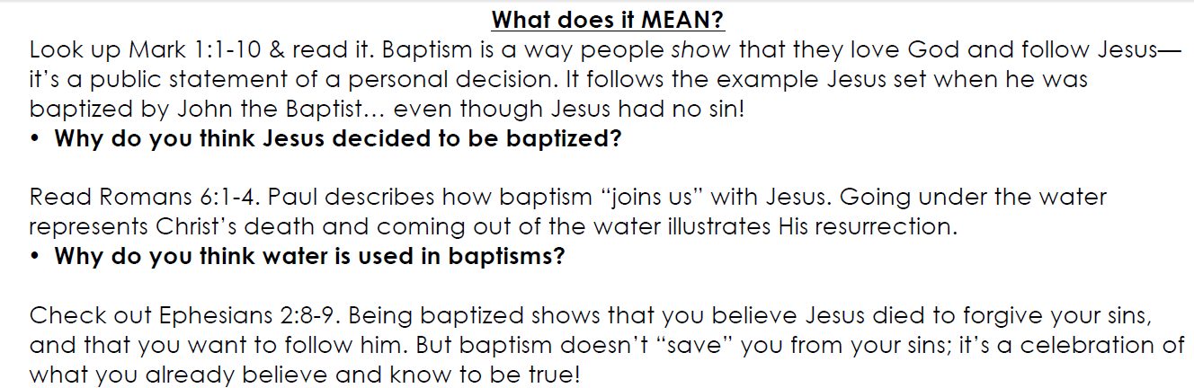
What they teach about BAPTISM
“Baptism is a way people show that they love God and follow Jesus—it’s a public statement of a personal decision.”
  http://www.iamelevate.com/wordpress/wp-content/uploads/2012/05/bapt-talk-sheet.pdf

Slide 8
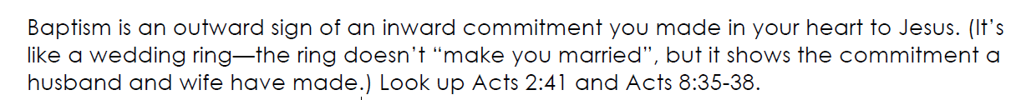
What they teach about BAPTISM
“Baptism is an outward sign of an inward commitment you made in your heart to Jesus. (It’s like a wedding ring—the ring doesn’t ‘make you married’, but it shows the commitment a husband and wife have made.)”
  http://www.iamelevate.com/wordpress/wp-content/uploads/2012/05/bapt-talk-sheet.pdf

Slide 9
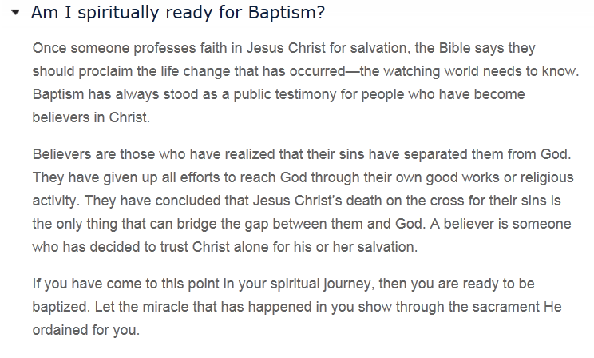
What they teach about BAPTISM

Slide 10
What they teach about BAPTISM
“Once someone professes faith in Jesus Christ for salvation, the Bible says they should proclaim the life change that has occurred—the watching world needs to know. Baptism has always stood as a public testimony for people who have become believers in Christ.”
  http://www.willowcreek.org/southbarrington/go-deeper/baptism-a-communion

Slide 11
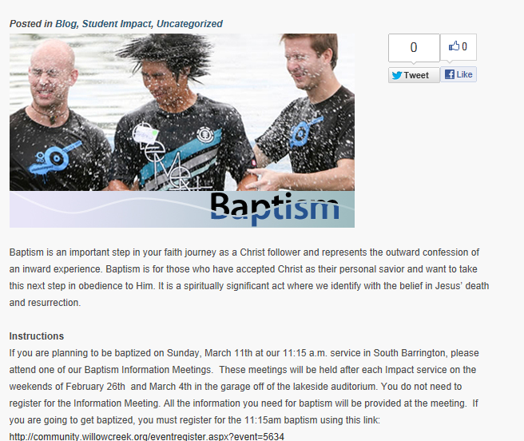
What they teach about BAPTISM

Slide 12
What they teach about BAPTISM
“Baptism is an important step in your faith journey as a Christ follower and represents the outward confession of an inward experience. Baptism is for those who have accepted Christ as their personal savior and want to take this next step in obedience to Him. It is a spiritually significant act where we identify with the belief in Jesus’ death and resurrection.”
  http://studentimpact.com/baptism-march-11th/

Slide 13
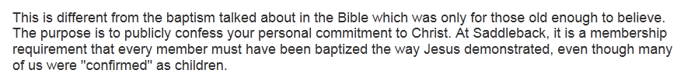
What they teach about BAPTISM
“The purpose is to publicly confess your personal commitment to Christ.”
  http://www.saddleback.com/aboutsaddleback/whatwebelieve/baptism/

Slide 14
What they teach about BAPTISM
“The Bible teaches that baptism is the first step of obedience after making a commitment to Christ. It is a spiritually empowering experience that God honors. Baptism allows Christ-followers to communicate to the world their new commitment to Christ.”
  http://gochristfellowship.com/events/baptism/

Slide 15
What they teach about BAPTISM
“Baptism…is a public expression of one who has embraced Jesus Christ as their Savior, Lord and King. Baptism is an outward expression of an inward grace received; it is a demonstration of a life that has been changed forever; it is a telling of the gospel story that tells those witnessing baptism that that person has died, been buried with Christ and has been raised as a new life in Him…
  Click on the “Baptism” video under “Conversation 1” on http://gochristfellowship.com/adults/journey/

Slide 16
The Teachings of Scripture on Baptism
There is no New Testament authority or support of any kind to teach that baptism is merely an outward sign (to proclaim to the world) that someone has already been saved.
Nowhere does the Bible depict baptism as a public display of one’s salvation obtained through faith. If it did, what would have been the purpose of baptism in Acts 8:38 and Acts 16:33?
Bible teaching is very plain and never refers to baptism in this way which man has invented and so frequently teaches.
In the Bible, baptism ALWAYS precedes salvation (i.e., the washing away of sins), with no exceptions

Slide 17
What they teach about BAPTISM
“But baptism doesn’t ‘save’ you from your sins; it’s a celebration of what you already believe and know to be true!”
  http://www.iamelevate.com/wordpress/wp-content/uploads/2012/05/bapt-talk-sheet.pdf

Slide 18
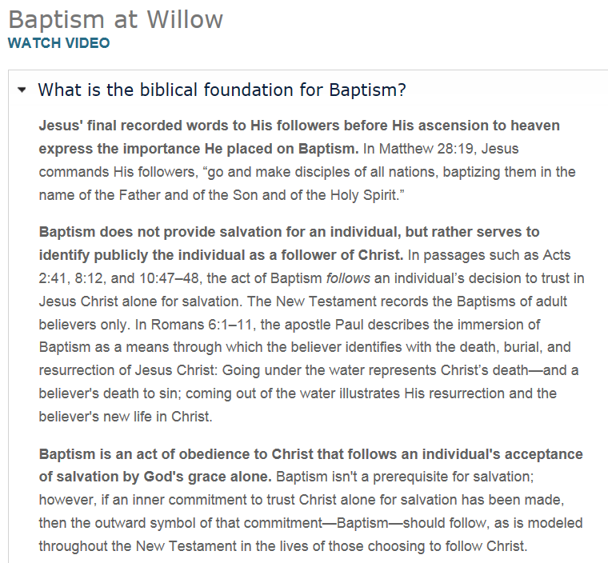
What they teach about BAPTISM
  http://www.willowcreek.org/southbarrington/go-deeper/baptism-a-communion

Slide 19
What they teach about BAPTISM
“Baptism does not provide salvation for an individual, but rather serves to identify publicly the individual as a follower of Christ. In passages such as Acts 2:41, 8:12, and 10:47–48, the act of Baptism follows an individual’s decision to trust in Jesus Christ alone for salvation.”
  http://www.willowcreek.org/southbarrington/go-deeper/baptism-a-communion

Slide 20
What they teach about BAPTISM
“Baptism is an act of obedience to Christ that follows an individual's acceptance of salvation by God's grace alone. Baptism isn't a prerequisite for salvation; however, if an inner commitment to trust Christ alone for salvation has been made, then the outward symbol of that commitment—Baptism—should follow, as is modeled throughout the New Testament in the lives of those choosing to follow Christ.”
  http://www.willowcreek.org/southbarrington/go-deeper/baptism-a-communion

Slide 21
What they teach about BAPTISM
“Baptism was never intended to provide salvation for an individual, but rather to publicly identify a person with Christ.”
  Website viewed on October 29, 2006 http://www.willowcreek.org/SpiritualFormation/Membership/Faqs.asp

Slide 22
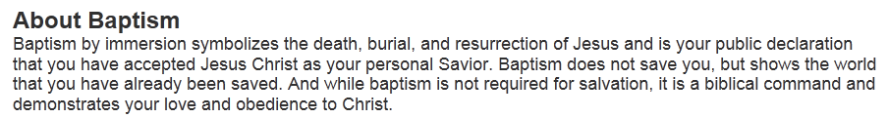
What they teach about BAPTISM
“Baptism by immersion symbolizes the death, burial, and resurrection of Jesus and is your public declaration that you have accepted Jesus Christ as your personal Savior. Baptism does not save you, but shows the world that you have already been saved. And while baptism is not required for salvation, it is a biblical command and demonstrates your love and obedience to Christ.”
  http://www.saddleback.com/aboutsaddleback/whatwebelieve/

Slide 23
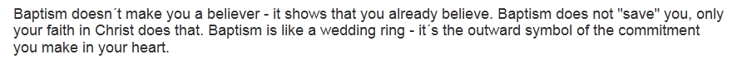
What they teach about BAPTISM
“Baptism doesn’t make you a believer - it shows that you already believe. Baptism does not ‘save’ you, only your faith in Christ does that. Baptism is like a wedding ring - it´s the outward symbol of the commitment you make in your heart.”
  http://www.saddleback.com/aboutsaddleback/whatwebelieve/baptism/

Slide 24
What they teach about BAPTISM
“The act of baptism does not in itself save a person; the resurrection of Jesus Christ does that. This happened for you about 2,000 years ago…”
  Click on the “Baptism” video under “Conversation 1” on http://gochristfellowship.com/adults/journey/

Slide 25
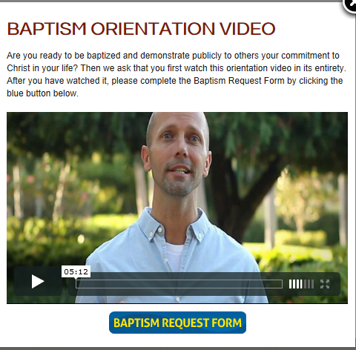
What they teach about BAPTISM
“Baptism Orientation Video” at http://vimeo.com/20878614
Or, click bottom page at http://gochristfellowship.com/events/baptism/

Slide 26
What they teach about BAPTISM
“Baptism does not save you. Only Christ saves you by grace through faith in Him” (01:20-01:26)
“You can be a Christian without being baptized…” (03:40-03:42).
  “Baptism Orientation Video” at http://vimeo.com/20878614
  Or, click bottom page at http://gochristfellowship.com/events/baptism/

Slide 27
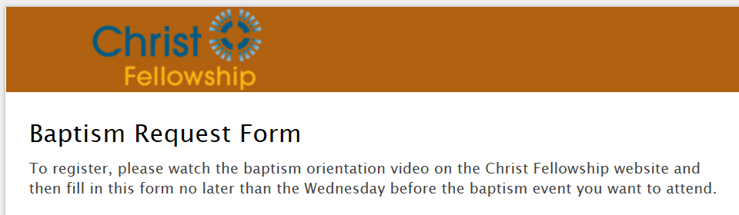
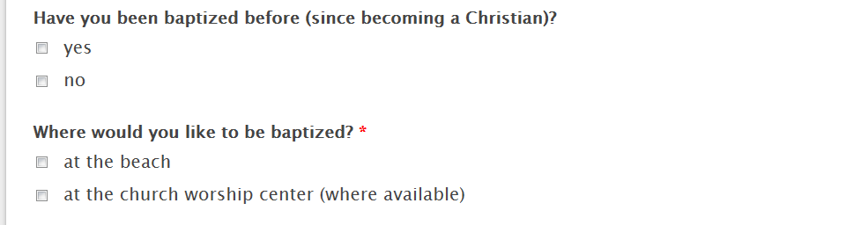
What they teach about BAPTISM
https://cftoday.wufoo.com/forms/k7s4s7/

Slide 28
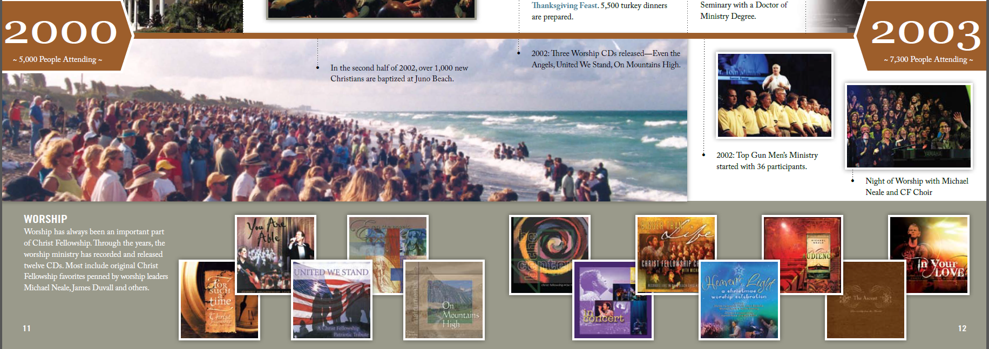
What they teach about BAPTISM
“In the second half of 2002, over 1,000 new Christians are baptized at Juno Beach.”
  http://gochristfellowship.com/fileadmin/Life_Groups/25th_Anniv/CF_25_Years_of_Impact_magazine_for_web.pdf

Slide 29
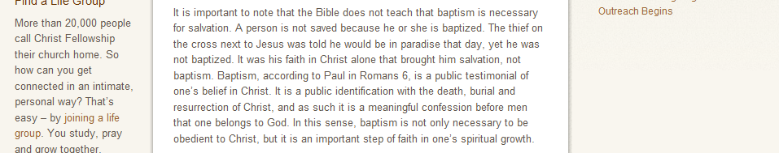
What they teach about BAPTISM
Actual Screenshot on November 9, 2010 from
http://gochristfellowship.com/grow-deep/spiritual-questions/church/how-important-is-baptism-for-a-believer

Slide 30
What they teach about BAPTISM
“It is important to note that the Bible does not teach that baptism is necessary for salvation. A person is not saved because he or she is baptized. The thief on the cross next to Jesus was told he would be in paradise that day, yet he was not baptized. It was his faith in Christ alone that brought him salvation, not baptism. Baptism, according to Paul in Romans 6, is a public testimonial of one’s belief in Christ. It is a public identification with the death, burial and resurrection of Christ, and as such it is a meaningful confession before men that one belongs to God. In this sense, baptism is not only necessary to be obedient to Christ, but it is an important step of faith in one’s spiritual growth.”

Slide 31
The Teachings of Scripture on Baptism
Baptism does NOT save? So says Community Churches.
God says that baptism stands between the sinner and…
  Becoming a Christian – Matthew 28:18-20
  Being saved from sins – Mark 16:16
  Entering into the kingdom of God – John 3:3-5
  Obtaining the remission of sins – Acts 2:38
  Having sins washed away – Acts 22:16
  Getting into Christ – Romans 6:3
  Having a new life in Christ – Romans 6:4
  Wearing the name of Christ – 1 Corinthians 1:12-17
  Becoming a child of God – Galatians 3:26-27
  Putting on Christ – Galatians 3:27
  Being saved – 1 Peter 3:21

Slide 32
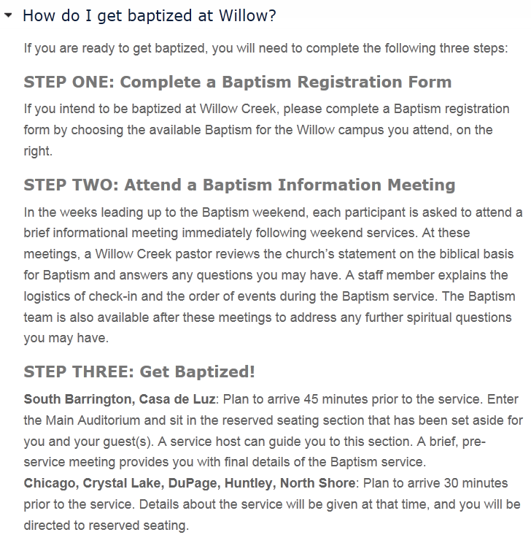
What they teach about BAPTISM

Slide 33
What they teach about BAPTISM
“If you are ready to get baptized, you will need to complete the following three steps:
“STEP ONE: Complete a Baptism Registration Form
  “If you intend to be baptized at Willow Creek, please complete a Baptism registration form by choosing the available Baptism for the Willow campus you attend, on the right.”
    http://www.willowcreek.org/southbarrington/go-deeper/baptism-a-communion

Slide 34
What they teach about BAPTISM
“STEP TWO: Attend a Baptism Information Meeting
  “In the weeks leading up to the Baptism weekend, each participant is asked to attend a brief informational meeting immediately following weekend services. At these meetings, a Willow Creek pastor reviews the church’s statement on the biblical basis for Baptism and answers any questions you may have. A staff member explains the logistics of check-in and the order of events during the Baptism service. The Baptism team is also available after these meetings to address any further spiritual questions you may have.”
    http://www.willowcreek.org/southbarrington/go-deeper/baptism-a-communion

Slide 35
What they teach about BAPTISM
“STEP THREE: Get Baptized!
  “South Barrington, Casa de Luz: Plan to arrive 45 minutes prior to the service. Enter the Main Auditorium and sit in the reserved seating section that has been set aside for you and your guest(s). A service host can guide you to this section. A brief, pre-service meeting provides you with final details of the Baptism service.
  Chicago, Crystal Lake, DuPage, Huntley, North Shore: Plan to arrive 30 minutes prior to the service. Details about the service will be given at that time, and you will be directed to reserved seating.”
    http://www.willowcreek.org/southbarrington/go-deeper/baptism-a-communion

Slide 36
What they teach about BAPTISM
“Willow offers indoor immersion Baptism on select weekends throughout the year, and a special outdoor Baptism service in the lake on campus each June.”
  http://www.iamelevate.com/2010/05/baptism/

Slide 37

What they teach about BAPTISM

Slide 38

What they teach about BAPTISM
http://www.willowcreek.org/chicago/about/baptism

Slide 39
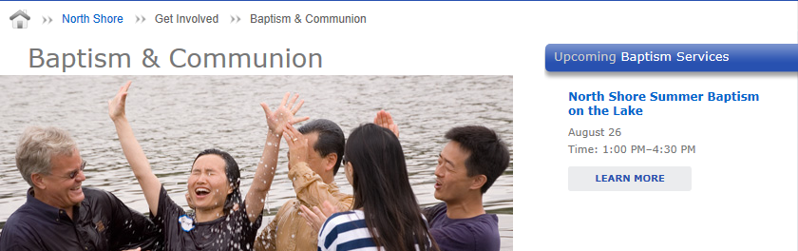
What they teach about BAPTISM
http://www.willowcreek.org/northshore/get-involved/baptism

Slide 40
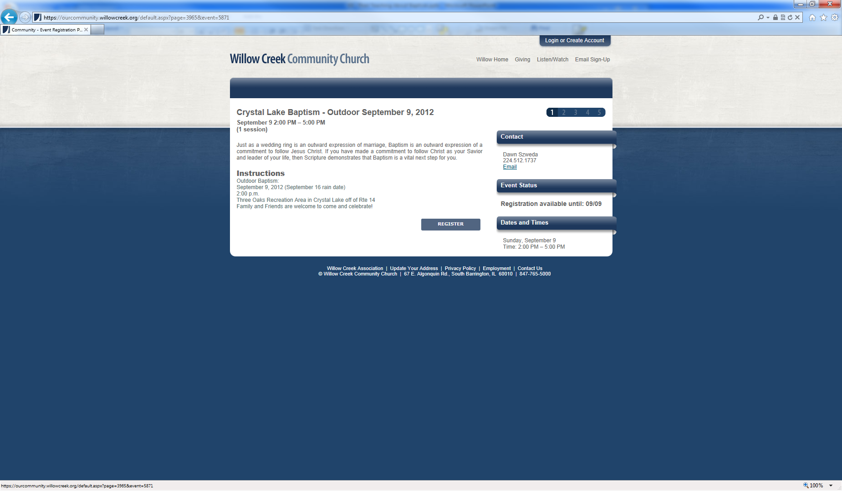
What they teach about BAPTISM
https://ourcommunity.willowcreek.org/default.aspx?page=3965&event=5871

Slide 41
What they teach about BAPTISM
“Baptism celebrations occur monthly, either at Willow Creek’s New Community or Weekend services. This allows for life change to be celebrated frequently.”
“In order to make the Baptism celebration more personal, we will accept the first 40 people to register per month.”
  Website viewed on October 29, 2006 http://www.willowcreek.org/baptism/service_info.asp

Slide 42

What they teach about BAPTISM
http://www.saddleback.com/events/eventdetails.aspx?id=51399

Slide 43
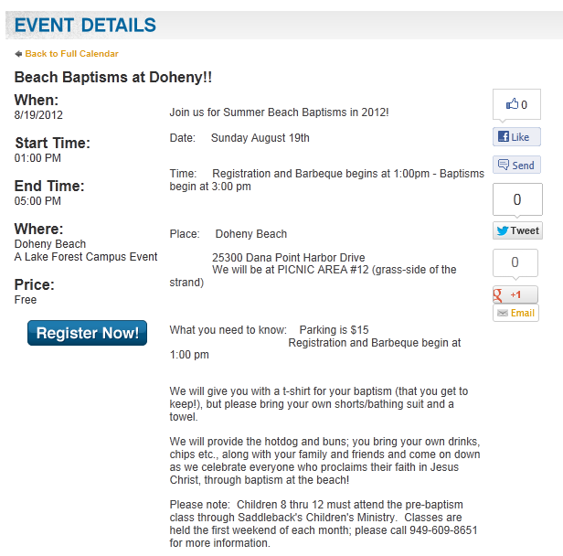
What they teach about BAPTISM
http://www.saddleback.com/events/eventdetails.aspx?id=49254

Slide 44
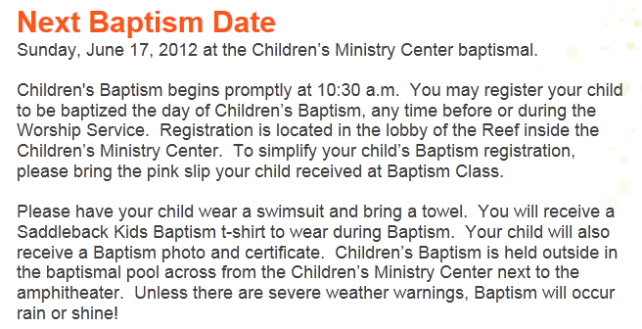
What they teach about BAPTISM
http://www.saddleback.com/lakeforest/children/childrensbaptism/

Slide 45
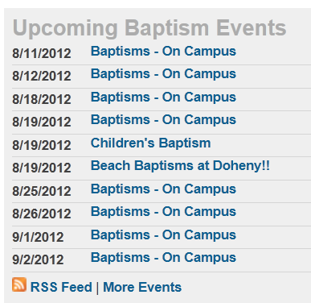
What they teach about BAPTISM
http://www.saddleback.com/LakeForest/aboutus/whatwebelieve/baptism/

Slide 46
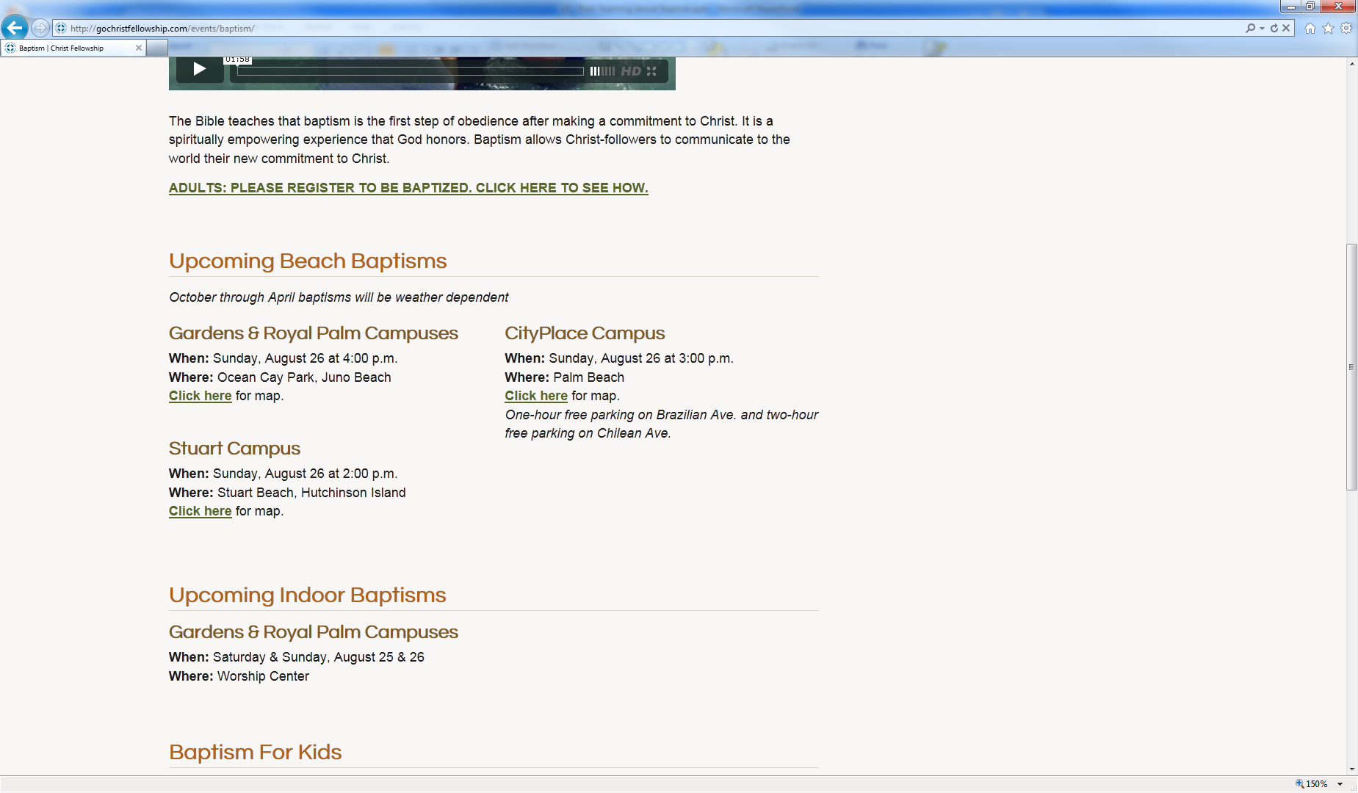
What they teach about BAPTISM
http://gochristfellowship.com/events/baptism/

Slide 47
What they teach about BAPTISM
http://gochristfellowship.com/events/baptism/

Slide 48
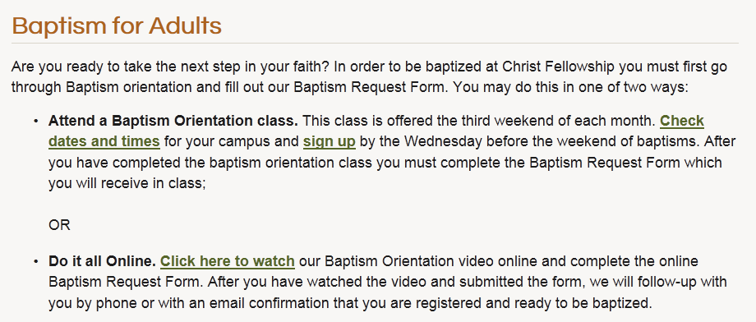
What they teach about BAPTISM
http://gochristfellowship.com/events/baptism/

Slide 49
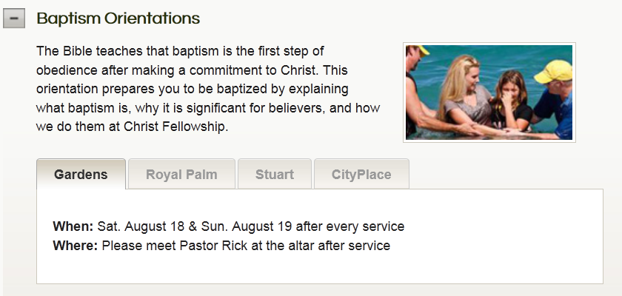
What they teach about BAPTISM
http://gochristfellowship.com/adults/life-studies/all-classes/#class-13

Slide 50
What they teach about BAPTISM
“Are you ready to take the next step in your faith? In order to be baptized at Christ Fellowship you must first go through Baptism orientation and fill out our Baptism Request Form. You may do this in one of two ways:
  “Attend a Baptism Orientation class. This class is offered the third weekend of each month. Check dates and times for your campus and sign up by the Wednesday before the weekend of baptisms. After you have completed the baptism orientation class you must complete the Baptism Request Form which you will receive in class; OR
  “Do it all Online. Click here to watch our Baptism Orientation video online and complete the online Baptism Request Form. After you have watched the video and submitted the form, we will follow-up with you by phone or with an email confirmation that you are registered and ready to be baptized.”
    http://gochristfellowship.com/events/baptism/

Slide 51
What they teach about BAPTISM
“Baptism Orientation Video” at http://vimeo.com/20878614
Or, click bottom page at http://gochristfellowship.com/events/baptism/

Slide 52
What they teach about BAPTISM
“Baptism happens the fourth weekend of almost every month at Christ Fellowship. You can schedule to be one of those who is baptized during one of our services or you can baptized at the beach during the summer months…” (00:10-00:21).
  “Baptism Orientation Video” at http://vimeo.com/20878614
  Or, click bottom page at http://gochristfellowship.com/events/baptism/

Slide 53
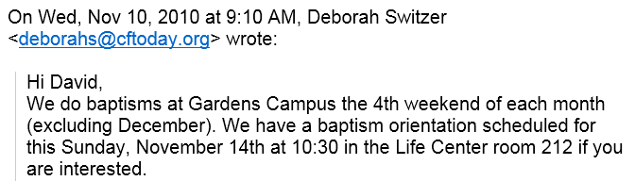
What they teach about BAPTISM
Hi David,
We do baptisms at Gardens Campus the 4th weekend of each month (excluding December). We have a baptism orientation scheduled for this Sunday, November 14th at 10:30 in the Life Center room 212 if you are interested.

Slide 54


What they teach about BAPTISM

Slide 55
The Teachings of Scripture on Baptism
Since baptism is essential to salvation, how could the decision/action possibly be delayed for any amount of time (especially days, weeks or months), and, therefore, remaining in a lost/damned condition for that time?
The Bible teaches that salvation is not something to put off (2 Cor. 6:2).
Baptism for remission of sins is an action that was (in the N.T.) and must be today an immediate action:
  “Why are you waiting?” – Acts 22:16
  “That day about 3,000 souls” – Acts 2:41
  “Immediately…he arose & was baptized” – Acts 9:18
  “Immediately…were baptized” – Acts 16:34

Slide 56
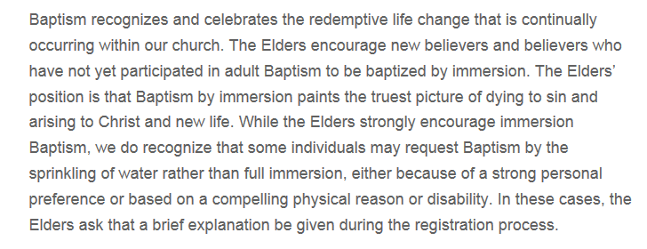
What they teach about BAPTISM
http://www.willowcreek.org/southbarrington/go-deeper/baptism-a-communion

Slide 57
What they teach about BAPTISM
“While the Elders strongly encourage immersion Baptism, we do recognize that some individuals may request Baptism by the sprinkling of water rather than full immersion, either because of a strong personal preference or based on a compelling physical reason or disability. In these cases, the Elders ask that a brief explanation be given during the registration process.”
  http://www.willowcreek.org/southbarrington/go-deeper/baptism-a-communion

Slide 58
What they teach about BAPTISM
“Willow Creek Community Church offers the option of believers’ baptism in the modes of sprinkling and immersion on the basis of a sacramentarian view of the ordinances whereby their value lies in the symbolism they convey and in the faith of the participants rather than the nature or amount of the elements used….”
  Website viewed on October 29, 2006
  http://www.willowcreek.org/statementonbaptism.asp

Slide 59
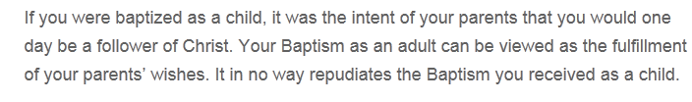
What they teach about BAPTISM
“If you were baptized as a child, it was the intent of your parents that you would one day be a follower of Christ. Your Baptism as an adult can be viewed as the fulfillment of your parents’ wishes. It in no way repudiates the Baptism you received as a child.”
  http://www.willowcreek.org/southbarrington/go-deeper/baptism-a-communion

Slide 60
The Teachings of Scripture on Baptism
Baptism is an immersion in water
  By definition
    Greek word baptizo means “to immerse, dip, submerge”
  By precept
    Romans 6:4
    Colossians 2:12
  Be example
    John 3:23
    Matthew 3:16
    Acts 8:38

Slide 61
The Teachings of Scripture on Baptism
The Bible not only does NOT teach that salvation is by faith alone but it emphatically denies it.
  James 2:14-26
  Mark 16:16 – “He who believes and ____ will be saved.”
    Whatever goes in the blank is equally as necessary as the believing. Jesus adds something to faith in this verse, thus, faith alone is not sufficient to save.
  Romans 10:13-14
    Read the verses backwards — a preacher leads to hearing leads to believing leads to calling leads to being saved.
    There is something beyond believing necessary for salvation.

