Slide 1
Lesson 4:
Their Teaching About Salvation (cont.)

Slide 2
What This Class Is NOT Intended to Do
Not to be unkind
Not to present a haughty, un-Christlike spirit
Not to attack Community Churches (in general)
Not to attack a particular Community Church
Not to treat them unjustly in any way
Not to misrepresent them in any way
Not to ridicule or belittle any person or organization
Not to say, “We’re so much better than you”

Slide 3
What This Class Is Intended to Do
To follow the soul-saving instructions of the Lord:
  “Beloved, do not believe every spirit, but test the spirits, whether they are of God…” (1 John 4:1; cf. 1 Thess. 5:21)
To follow the highly-praised example of the Bereans:
  “…They received the word with all readiness, and searched the Scriptures daily to find out whether these things were so” (Acts 17:11).
To fairly examine the teachings of a popular religious movement in light of the teachings of Scripture, by presenting their teachings in their own words and comparing them with God’s teachings in His own Words
  Psa. 119:105, 130; John 3:19-21; 2 Cor. 4:4-6; Eph. 5:13; 2 Pet. 1:19
To examine whether we are in “the faith”/“the truth” (2 Cor. 13:5-7), as there is only “one faith” (Eph. 4:4-6)
To sharpen our knowledge, inform our hearts and fortify our faith in the faith of the gospel (2 Pet. 3:15; Jude 3; Prov. 3:5-6)

Slide 4
What they teach about SALVATION
“Each person can receive salvation by repentance and faith.”
  (http://www.willowcreek.org/aboutwillow/what-willow-believes)
“Salvation only comes through Jesus Christ as each person recognizes his or her sinfulness and receives forgiveness and eternal life through Jesus Christ as their personal Lord and Savior.”
  (http://www.willowcreek.org/crystallake/belong/child-dedication)

Slide 5
What they teach about SALVATION
“Pray to Receive Jesus
  “Ask Jesus to forgive you for your wrongs (sins).
  “Trust in Jesus for paying the price for your sin.
  “Turn and follow Jesus.
  “Receive Jesus to be your Savior and Lord [the one who forgives you and you will follow]. Thank Him!”
    (http://media.willowcreek.org/wp-content/files_mf/knowingandenjoying_wk4_handout.pdf)

Slide 6
What they teach about SALVATION
“Only by trusting in Jesus Christ as God’s offer of forgiveness can man be saved from sin’s penalty. Eternal life begins the moment one receives Jesus Christ into his life by faith…[Declare] that you have accepted Jesus Christ as your personal Savior.”
  (http://www.saddleback.com/aboutsaddleback/whatwebelieve/)
“You need to have accepted Jesus Christ as your Lord and Savior.”
  (http://www.saddleback.com/lakeforest/adults/
  smallgrouplife/faq/)

Slide 7
What they teach about SALVATION
“If you have not yet accepted Christ into your heart as your personal savior, this could be what is causing your engine to stall. If so, then let’s pray now. “
  “Dear Lord, I want to walk beside you and know you as others do. I want you to reside in my heart and soul and keep my spiritual tank full of your love and forgiveness. Please come into my heart now and wipe away the sins of my past. Forgive me for not being a good example of who you are and thank you for taking me into your kingdom. I want to remain on full in your word and not waste the precious fuel for life you have given me for free. Thank you Lord. Amen.”
    (http://www.saddleback.com/story/6085.html)

Slide 8
What they teach about SALVATION
“We believe that salvation is found by placing our faith in what Jesus did for us on the cross.”
  (http://www.lakewood.cc/pages/new-here/what-we-believe.aspx)
“In order to receive salvation, a person must be of an age where they understand what salvation is and, as an act of their own will, pray to receive Jesus Christ as their Lord and Savior. We believe the minimum age for this is five.”
  (http://www.lakewood.cc/Downloads/PDF/NewHere_WhatWeBelieve_WaterBaptism.pdf)
“When we receive Jesus as our Lord and Savior, we can celebrate our salvation.”
  (http://www.lakewood.cc/pages/ministries/BlogDetail.aspx?bid=415)
“Jesus wants to have a personal relationship with us. All we have to do is receive it by faith, and come to Him just the way we are.”
  (http://www.lakewood.cc/pages/pathway/jesus.aspx)

Slide 9
What they teach about SALVATION
“Salvation is by grace, a gift of God apart from works. Salvation requires repentance, a turning away from one’s own way to God's way. Salvation is through personal faith in the Lord Jesus Christ and all who receive Him are born again, regenerated by the Holy Spirit, and become the children of God. We will manifest true salvation by a changed life.”
  (http://gochristfellowship.com/about-us/new-here/core-beliefs/)

Slide 10
What they teach about SALVATION
“Salvation is given by God’s grace based upon our faith in Christ alone.”
  Actual Screenshot on November 9, 2010 from http://gochristfellowship.com/grow-deep/spiritual-questions/gods-law/why-did-god-give-us-the-ten-commandments/

Slide 11
What they teach about SALVATION
“We believe that salvation is by faith alone.”
  From online video, “We Believe” (01:31 time mark)
  (http://vidego.multicastmedia.com/player.php?v=krs0eyg7)

Slide 12
The Teachings of Scripture on Salvation
The Bible not only does NOT teach that salvation is by faith alone but it emphatically denies it.
  James 2:14-26
  Mark 16:16 – “He who believes and ____ will be saved.”
    Whatever goes in the blank is equally as necessary as the believing. Jesus adds something to faith in this verse, thus, faith alone is not sufficient to save.
  Romans 10:13-14
    Read the verses backwards — a preacher leads to hearing leads to believing leads to calling leads to being saved.
    There is something beyond believing necessary for salvation.

Slide 13
The Teachings of Scripture on Salvation
Look carefully at the Community Church teaching again:
  “We believe that salvation is by faith alone.”
  “Salvation requires repentance…”
Question: Is salvation by faith alone?
Or, does salvation require repentance?
  It cannot be both, for the word “alone” excludes any other requirements. By teaching human doctrine and not taking heed to the teaching of Scripture, they not only contradict the Bible in their teachings but they also end up contradicting themselves.
The Bible teaches that salvation is by faith. However, it definitely does not teach that salvation is obtained by faith alone.

Slide 14
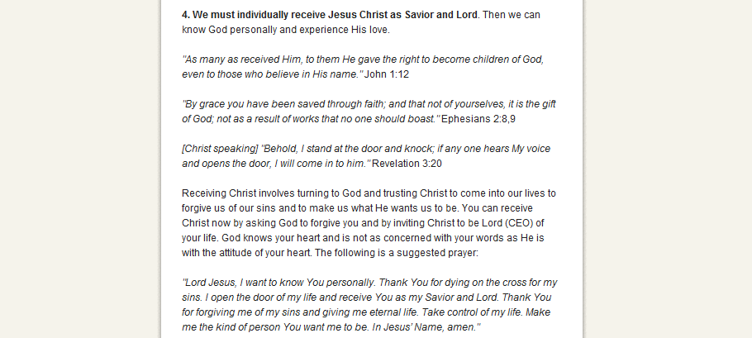
What they teach about SALVATION
  Actual Screenshot on November 9, 2010 from http://gochristfellowship.com/about-us/new-here/need-a-change/

Slide 15
What they teach about SALVATION
“4. We must individually receive Jesus Christ as Savior and Lord.
  “John 1:12; Ephesians 2:8,9; Revelation 3:20
  “Receiving Christ involves turning to God and trusting Christ to come into our lives to forgive us of our sins and to make us what He wants us to be. You can receive Christ now by asking God to forgive you and by inviting Christ to be Lord (CEO) of your life. God knows your heart and is not as concerned with your words as He is with the attitude of your heart. The following is a suggested prayer:
    “Lord Jesus, I want to know You personally. Thank You for dying on the cross for my sins. I open the door of my life and receive You as my Savior and Lord. Thank You for forgiving me of my sins and giving me eternal life. Take control of my life. Make me the kind of person You want me to be. In Jesus’ Name, amen.”
  (http://gochristfellowship.com/about-us/new-here/need-a-change/)

Slide 16
The Teachings of Scripture on Salvation
“Receiving Jesus” is a favorite expression in denominationalism, which has been and can be applied ambiguously. However, the Bible does NOT use this expression to talk about the salvation process, so it is critical to look at how the Bible uses words.
John 1:11-12 — “He came to His own, and His own did not receive Him. But as many as received Him, to them He gave the right to become children of God, to those who believe in His name.”
  In this passage are three distinct groups:
    Those who did not receive Jesus
    Those who did receive Jesus
    Those who became children of God
  Those who received Him were NOT automatically children of God. Look at the words: TO those who received Him, Jesus GAVE THE RIGHT to become children of God. They weren’t children of God yet, but they had the privilege to do so, if they chose. One cannot become what he already is.
Consider also Matthew 18:5; Colossians 2:6-7; 1 Thess. 4:1

Slide 17
The Teachings of Scripture on Salvation
There is not one — not one single solitary — command, implied command, example or even hint in the New Testament that one can have their sins washed away by praying, “asking God to forgive you and by inviting Christ to be Lord of your life.” The Lord will make you His CHILD, but ONLY when you obey what the FATHER says to do (Matt. 7:21). There is no other authority (cf. Col. 3:17).
Saul of Tarsus was the “chief of sinners” (cf. 1 Tim. 1:15). The Lord appeared to him and told him to go into Damascus and there he would be told what he “must do” (Acts 9:6). Saul fasted and prayed for three days (Acts 9:9-11). Was he saved by praying? No! Ananias came and told him what he “must do” to “wash away his sins” (cf. Acts 22:16). Saul still had his sins after praying for 3 days.
Interesting, on another page, Christ Fellowship affirmed, “Creator God...is not obligated to answer the prayers of non-Christians” (http://gochristfellowship.com/grow-deep/spiritual-questions/ world-religion/does-god-answer-the-prayers-of-the-non-christians). That’s true!

Slide 18
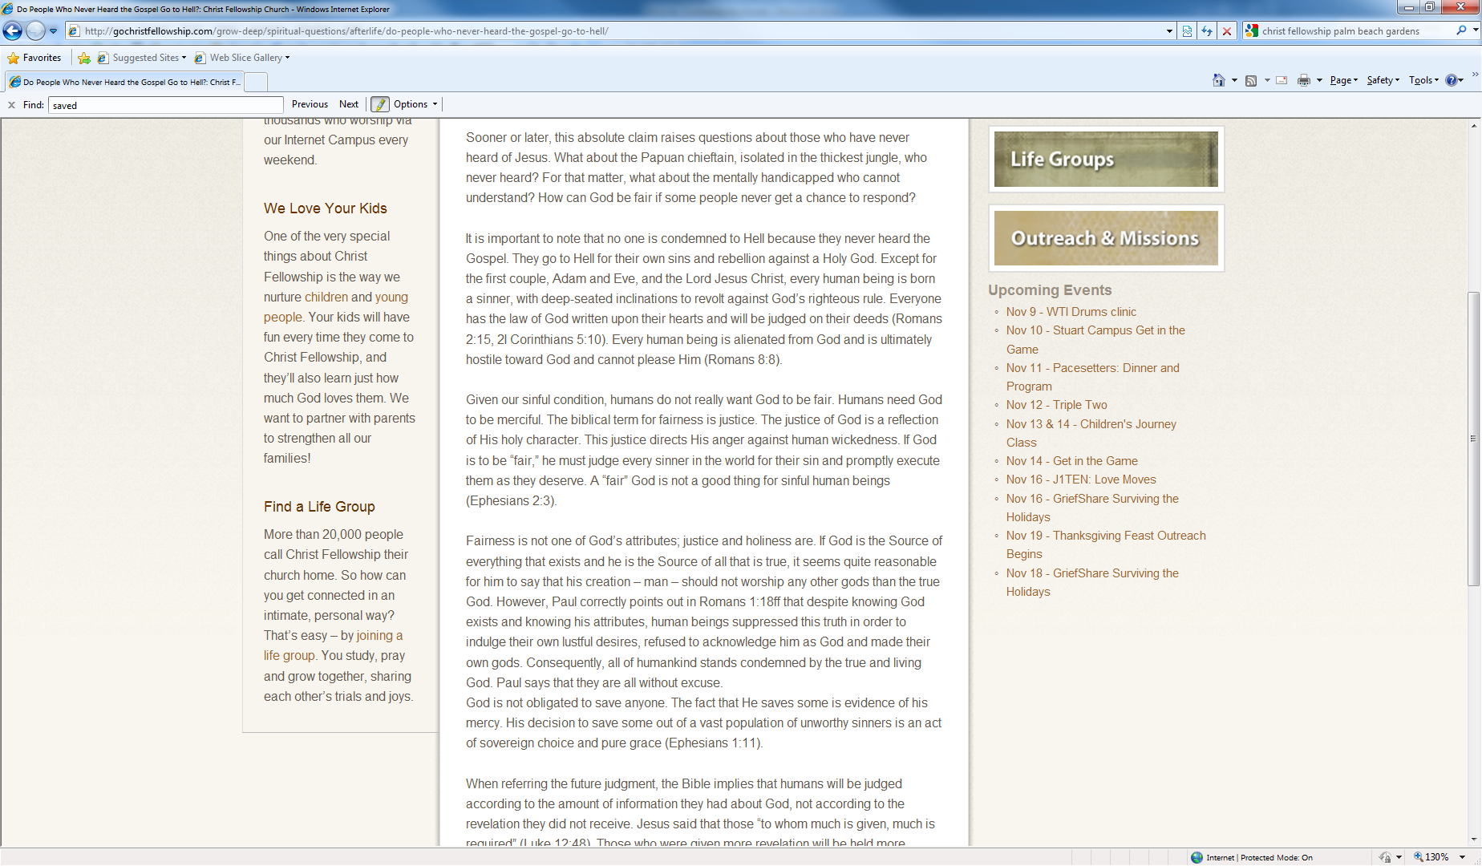
What they teach about SALVATION
“It is important to note that no one is condemned to Hell because they never heard the Gospel.”
“When referring the future judgment, the Bible implies that humans will be judged according to the amount of information they had about God, not according to the revelation they did not receive.”
  Actual Screenshots on Nov. 9, 2010 from http://gochristfellowship.com/ grow-deep/spiritual-questions/afterlife/do-people-who-never-heard-the-
  gospel-go-to-hell/

Slide 19
The Teachings of Scripture on Salvation
2 Thessalonians 1:7-10
  “...when the Lord Jesus is revealed from heaven with His mighty angels, in flaming fire taking vengeance on those who do not know God, and on those who do not obey the gospel of our Lord Jesus Christ. These shall be punished with everlasting destruction from the presence of the Lord and from the glory of His power, when He comes, in that Day…”
Revelation 20:12
  “And I saw the dead, small and great, standing before God, and books were opened. And another book was opened, which is the Book of Life. And the dead were judged according to their works, by the things which were written in the books” (cf. 2 Cor. 5:10; John 12:48).
If man is judged according to the amount of information he has, shouldn’t we stop giving him more information?

Slide 20
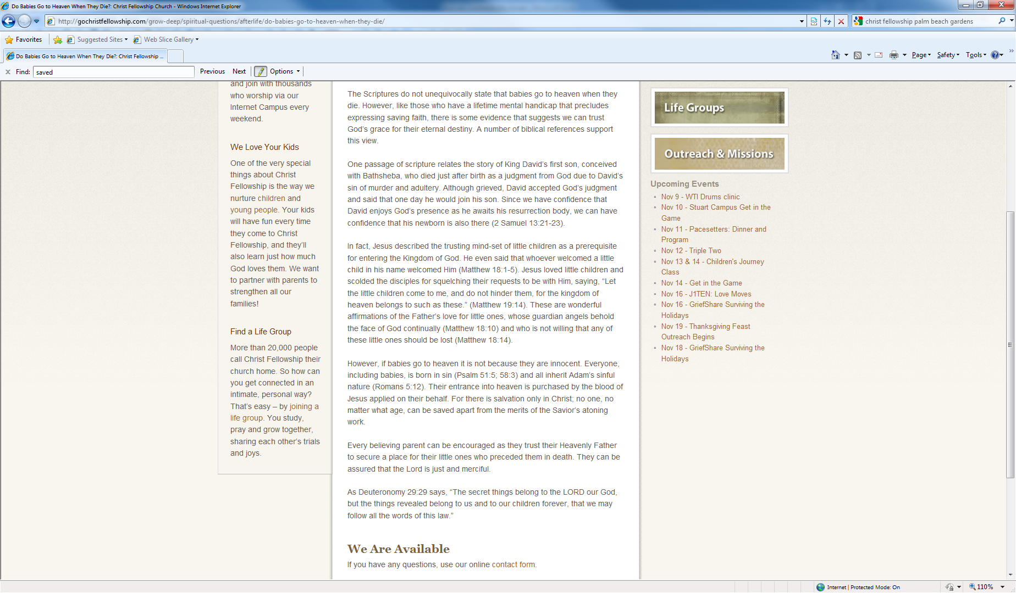
What they teach about SALVATION
“It is important to note that no one is condemned to Hell because they never heard the Gospel. They go to Hell for their own sins and rebellion against a Holy God. Except for the first couple, Adam and Eve, and the Lord Jesus Christ, every human being is born a sinner, with deep-seated inclinations to revolt against God’s righteous rule.”
“However, if babies go to heaven it is not because they are innocent. Everyone, including babies, is born in sin (Psalm 51:5; 58:3) and all inherit Adam’s sinful nature (Romans 5:12).”
  Actual Screenshots on Nov. 9, 2010 from
  http://gochristfellowship.com/grow-deep/spiritual-questions/afterlife/do-people-who-never-heard-the-gospel-go-to-hell/
  http://gochristfellowship.com/grow-deep/spiritual-questions/afterlife/do-babies-go-to-heaven-when-they-die/

Slide 21
The Teachings of Scripture on Salvation
No Bible passage teaches that a baby is born in sin (born a sinner) or inherits sin! The Bible plainly teaches that a person’s sins, which separate him/her from God, are committed personally and not inherited!
  Matthew 18:3; 19:14
  Ezekiel 18:19-20
  Deuteronomy 24:16
  2 Corinthians 5:10
  1 John 3:4
Sin is an act that one commits, not something anyone inherits.
Notice that they teach this truth, “They go to Hell for their own sins and rebellion against a Holy God” (their own sins). But, then they refute that and contradict it in the very next sentence.

Slide 22
The Teachings of Scripture on Salvation
Jesus “became the author of eternal salvation to all who obey Him” (Heb. 5:9).
“We ought to obey God rather than men” (Acts 5:29).
“Not everyone who says to Me, ‘Lord, Lord,’ shall enter the kingdom of heaven, but he who does the will of My Father in heaven” (Matt. 7:21).

