Slide 1
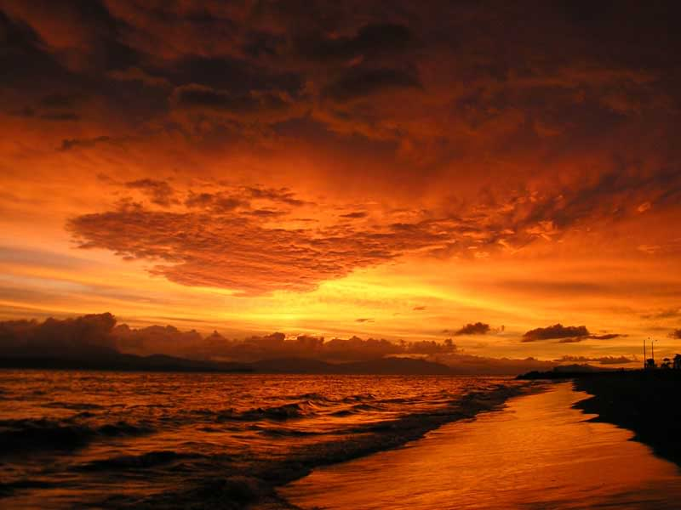
GOD’S
CREATION IS AWESOME

Slide 4
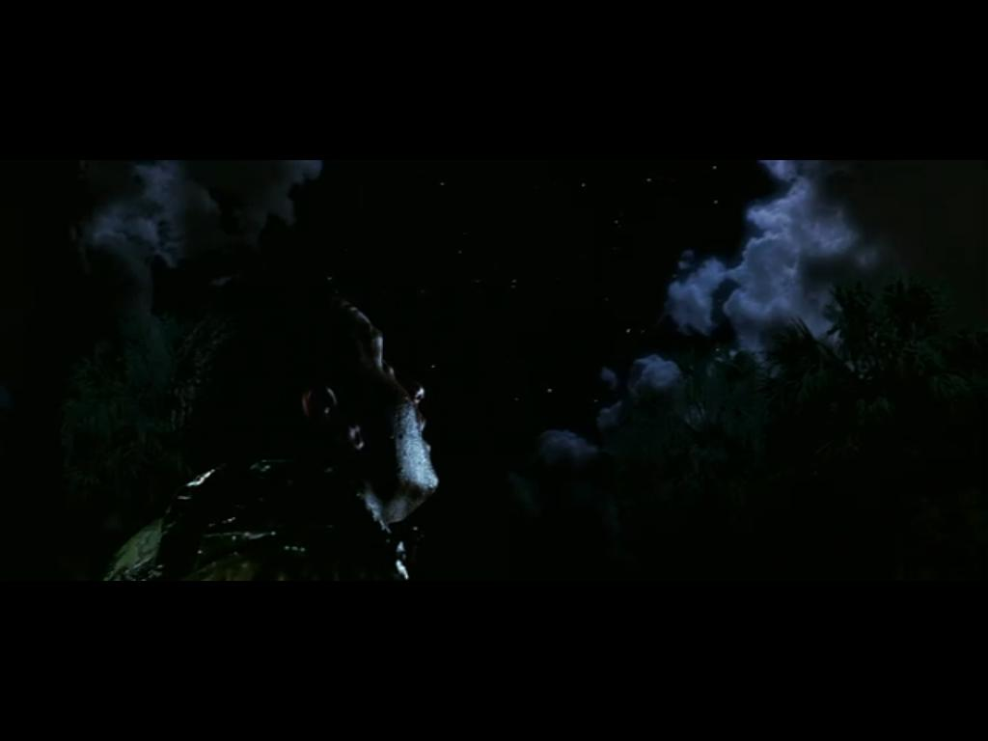
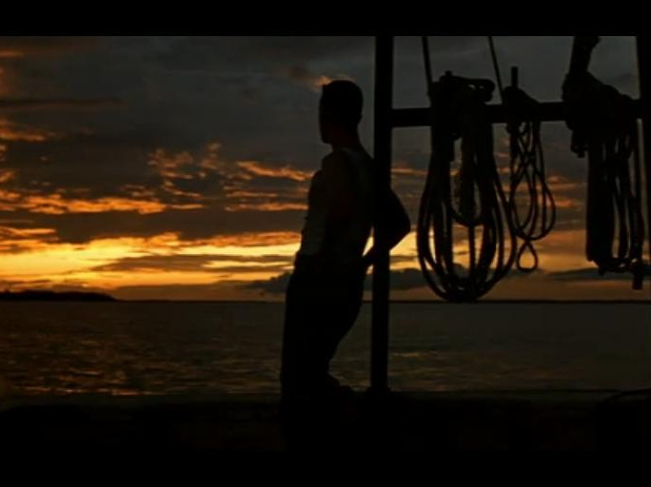
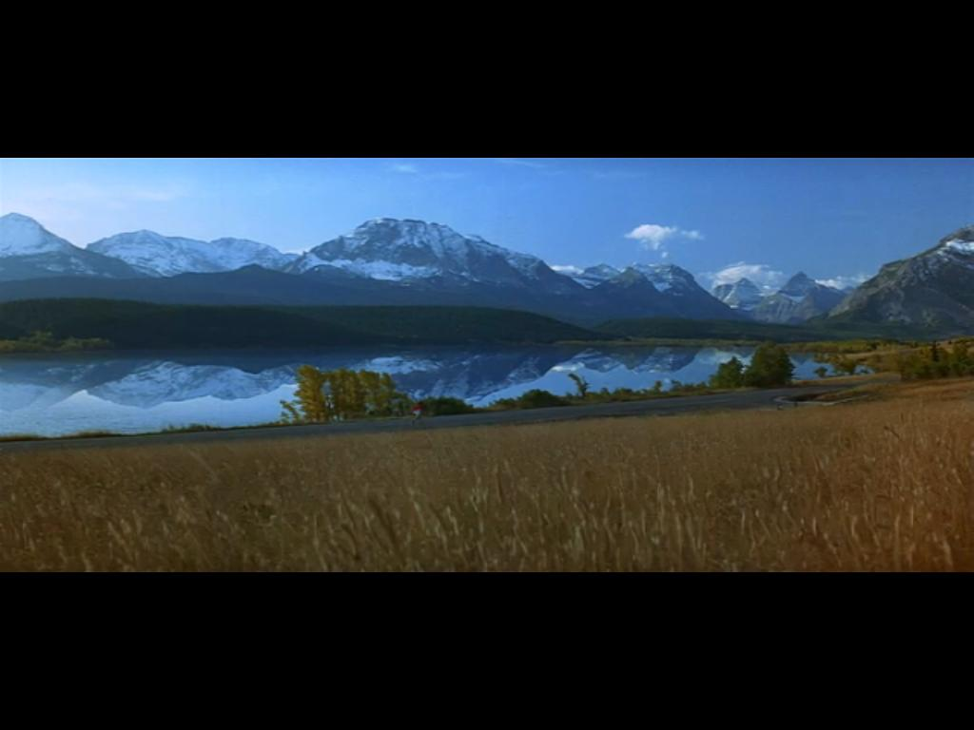
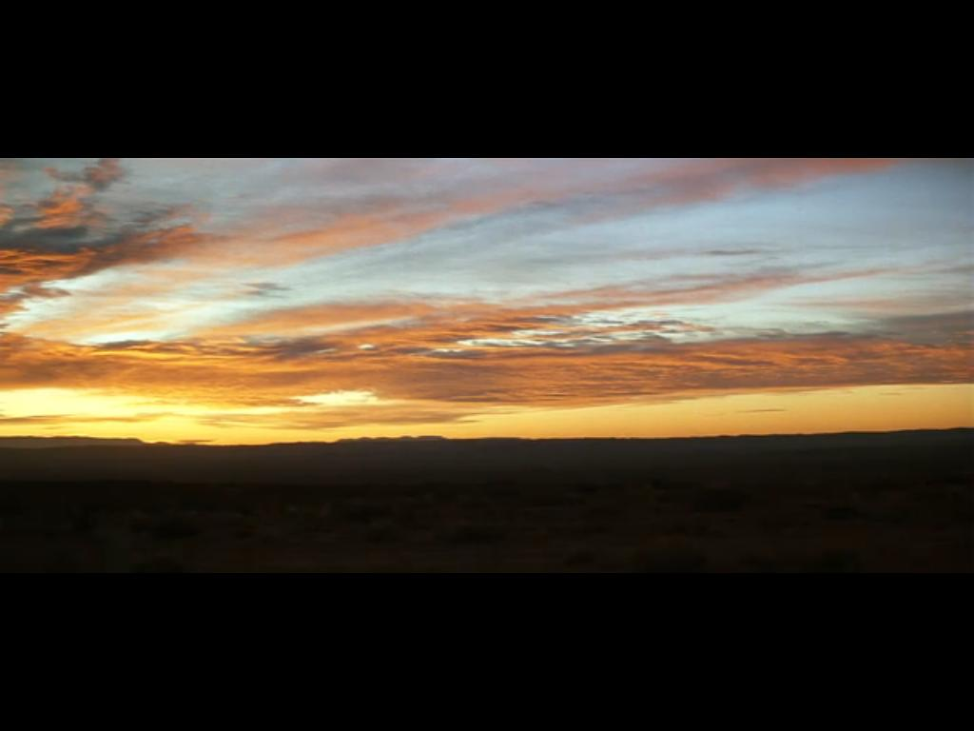

Slide 5
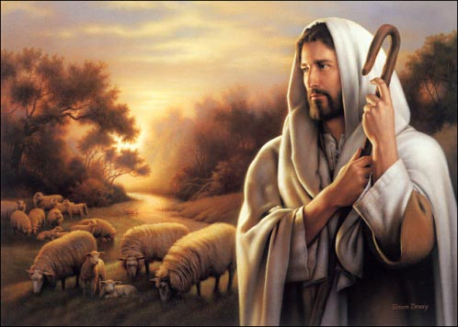
When I consider Your heavens, the work of Your fingers, the moon and the stars, which You have ordained, what is man that You are mindful of him...
Psalm 8:3-4

Slide 6
The heavens declare the glory of God; And the firmament shows His handiwork.
Psalm 19:1

Slide 7
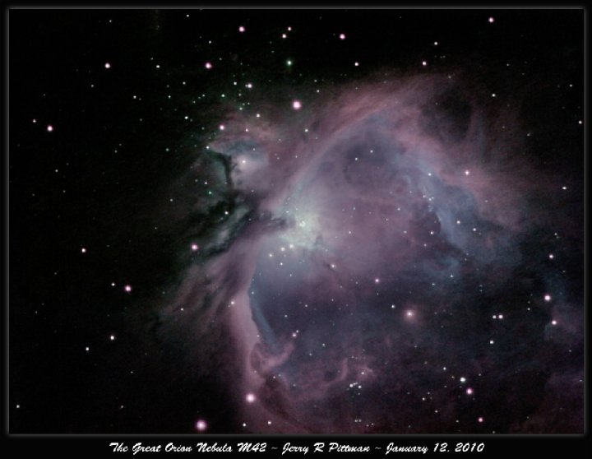
He made the Pleiades and Orion; He turns the shadow of death into morning and makes the day dark as night; He calls for the waters of the sea And pours them out on the face of the earth; The LORD is His name.
Amos 5:8

Slide 9
ORDERLINESS OF CREATION
Gen 1:1 - In the beginning God created the heavens and the earth.
Gen 1:2 - The earth was without form, and void; and darkness was on the face of the deep.
Fixed on Days 1-3
Fixed on Days 4-6
Day 1 (vs. 3-5)
Light
Day 4 (vs. 14-19)
Sun/Moon/Stars
God formed and then He filled.
Day 2 (vs. 6-8) Air/Water
Day 5 (vs. 20-23)
Birds/Fish
Day 3 (vs. 9-13)
Dry Land/Vegatation
Day 6 (vs. 24-31)
Animal/Beast/Man

Slide 10
ORDERLINESS OF CREATION
God is and always has been a God of order.
Genesis 1:4; 1:6; 1:9 – key verb
DIVIDE – God requires/provides separation
Genesis 11 & 12 – Abraham from Ur
Exodus – Israelites from Egyptian bondage
Judges – Don’t intermarry with nations around them
Romans 12:2 – Do not be conformed to this world…
The church – “Ecclesia” – the called out..

Slide 11
ORDERLINESS OF CREATION
God is and always has been a God of order.
Genesis 1:4; 1:6; 1:9 – key verb
DIVIDE – God requires/provides separation
John 17:14-17 - ¹⁴ I have given them Your word; and the world has hated them because they are not of the world, just as I am not of the world. ¹⁵ I do not pray that You should take them out of the world, but that You should keep them from the evil one. ¹⁶ They are not of the world, just as I am not of the world. ¹⁷ Sanctify them by Your truth. Your word is truth.

Slide 12
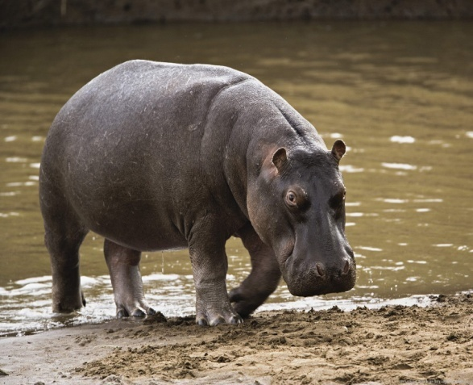
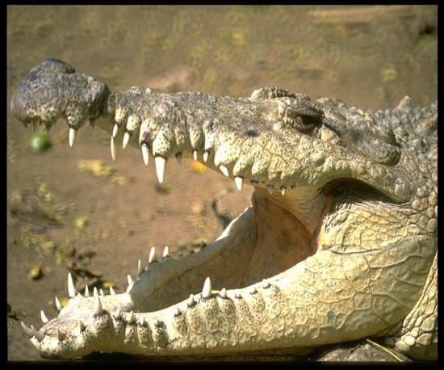
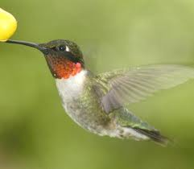
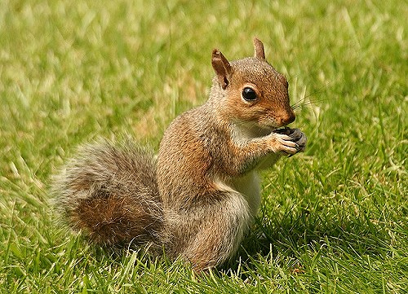
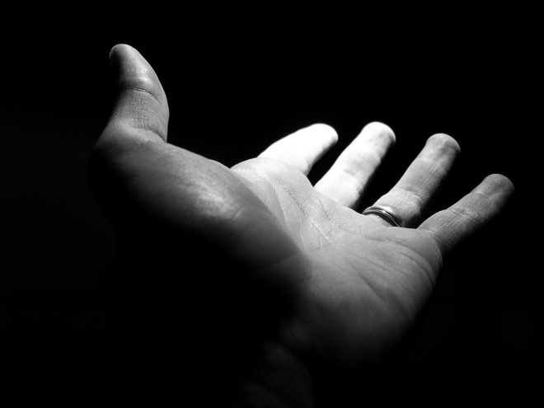
GOD’S
CREATION IS AWESOME
I will praise You, for I am fearfully and wonderfully made; Marvelous are Your works, and that my soul knows very well. Psalm 139:14

Slide 13
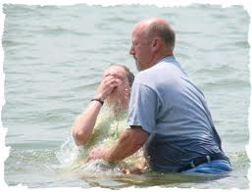
GOD’S
CREATION IS AWESOME
I will praise You, for I am fearfully and wonderfully made; Marvelous are Your works, and that my soul knows very well.
Psalm 139:14
Therefore, if anyone is in Christ, he is a new creation.
2 Corinthians 5:17

