Slide 1
SEEKING THINGS ABOVE Colossians 3:1

Slide 2
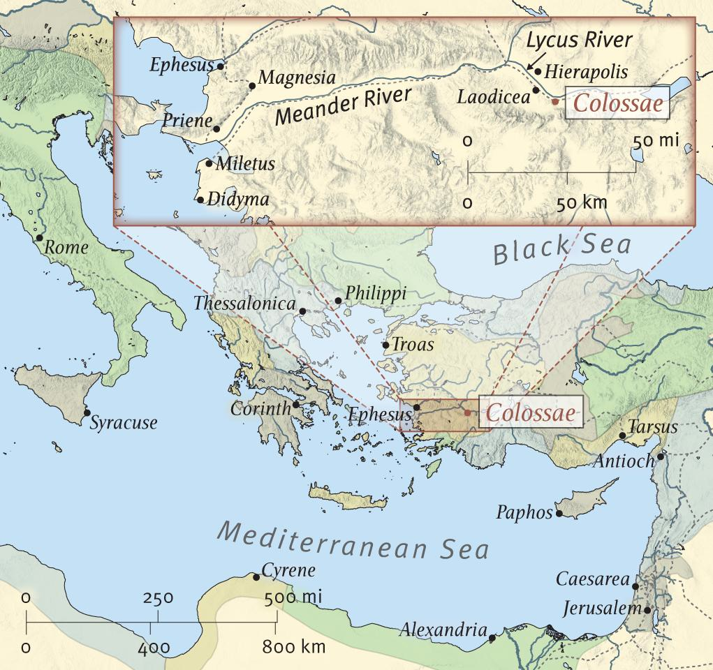
The Church at Colossae
Located in today’s Modern Turkey
Close to Laodicea and Hierapolis
Ancient trade route from Euphrates valley to Ephesus
Church started by Epaphras and Timothy possibly while Paul was in Ephesus
Home to Philemon and Epaphras
Written by Paul AD 61 by the urging of Epaphras likely the same year that Paul wrote to Philemon

Slide 3
Pressures on Colossae
This epistle was written at the request of Epaphras, who wanted to bring the full weight of Paul’s apostleship to bear in dealing with certain problems that had developed in this church (some of which Paul was already very familiar).
Judaizers had infiltrated this church as well. But, to add to the confusion, there was also a heavy influence of both Greek Philosophy and Oriental Mysticism. As a result, angel worship and the importance of "spiritual" knowledge were added to the mix of legalism.

Slide 4
Colossians 3: Text
3:1* If then you were raised with Christ, seek those things which are above, where Christ is, sitting at the right hand of God.
2* Set your mind on things above, not on things on the earth. 3* For you died, and your life is hidden with Christ in God. 4* When Christ who is our life appears, then you also will appear with Him in glory.
5* Therefore put to death your members which are on the earth: fornication, uncleanness, passion, evil desire, and covetousness, which is idolatry. 6* Because of these things the wrath of God is coming upon the sons of disobedience, 7* in which you yourselves once walked when you lived in them.
8* But now you yourselves are to put off all these: anger, wrath, malice, blasphemy, filthy language out of your mouth. 9* Do not lie to one another, since you have put off the old man with his deeds, 10* and have put on the new man who is renewed in knowledge according to the image of Him who created him, 11* where there is neither Greek nor Jew, circumcised nor uncircumcised, barbarian, Scythian, slave nor free, but Christ is all and in all.

Slide 5
Colossians 3: Text
12* Therefore, as the elect of God, holy and beloved, put on tender mercies, kindness, humility, meekness, longsuffering; 13* bearing with one another, and forgiving one another, if anyone has a complaint against another; even as Christ forgave you, so you also must do. 14* But above all these things put on love, which is the bond of perfection. 15* And let the peace of God rule in your hearts, to which also you were called in one body; and be thankful. 16* Let the word of Christ dwell in you richly in all wisdom, teaching and admonishing one another in psalms and hymns and spiritual songs, singing with grace in your hearts to the Lord. 17* And whatever you do in word or deed, do all in the name of the Lord Jesus, giving thanks to God the Father through Him.

Slide 6
Colossians 3: Text
18* Wives, submit to your own husbands, as is fitting in the Lord. 19* Husbands, love your wives and do not be bitter toward them. 20* Children, obey your parents in all things, for this is well pleasing to the Lord. 21* Fathers, do not provoke your children, lest they become discouraged. 22* Bondservants, obey in all things your masters according to the flesh, not with eyeservice, as men-pleasers, but in sincerity of heart, fearing God. 23 And whatever you do, do it heartily, as to the Lord and not to men, 24 knowing that from the Lord you will receive the reward of the inheritance; for you serve the Lord Christ. 25 But he who does wrong will be repaid for what he has done, and there is no partiality.

Slide 7
Paul’s Admonition to the Church
3:1* If then you were raised with Christ,
seek those things which are above

Slide 8
What Personal Core Capabilities are Used to Seek
Eyes
Ears
Speech
Hands/Feet
Mind

Slide 9
Practical
Seek those things that are above.
Lets look at our typical 24 hr. day.
Wake
Groom
Dress
Breakfast
Transit to work
Work
Lunch
Work
Transit Home
After Work
Dinner
At home
Bed

Slide 10
How do you seek things above?
Wake
Groom
Dress
Breakfast

Slide 11
How do you seek things above?
Transit to work
Work
Lunch
Work
Transit Home

Slide 12
How do you seek things above?
After Work
Dinner
At home
Bed

Slide 13
Actions from Colossians 3
3:5 put to death your members which are on the earth:
fornication, uncleanness, passion, evil desire, and covetousness, which is idolatry
3:8 put off all these:
anger, wrath, malice, blasphemy, filthy language out of your mouth.
3:9 Do not lie to one another

Slide 14
Actions from Colossians 3
PUT ON
3:10 the new man who is renewed in knowledge according to the image of Him who created him
3:12 tender mercies, kindness, humility, meekness, longsuffering
3:13 bearing with one another, and forgiving one another,
3:13 if anyone has a complaint against another; even as Christ forgave you, so you also must do.
3:14 But above all these things put on love
3:15 And let the peace of God rule in your hearts
3:15 be thankful
3:16 Let the word of Christ dwell in you richly in all wisdom
3:16 teaching and admonishing one another in psalms and hymns and spiritual songs, singing with grace in your hearts to the Lord.
3: 16 And whatever you do in word or deed, do all in the name of the Lord Jesus, giving thanks to God the Father through Him.

Slide 15
Actions from Colossians 3
18* Wives, submit to your own husbands, as is fitting in the Lord.
19* Husbands, love your wives and do not be bitter toward them.
20* Children, obey your parents in all things, for this is well pleasing to the Lord.
21* Fathers, do not provoke your children, lest they become discouraged.
22* Bondservants, obey in all things your masters according to the flesh, not with eyeservice, as men-pleasers, but in sincerity of heart, fearing God.
23 And whatever you do, do it heartily, as to the Lord and not to men, 24 knowing that from the Lord you will receive the reward of the inheritance; for you serve the Lord Christ.
25 But he who does wrong will be repaid for what he has done, and there is no partiality.

Slide 16
Your Personal Actions to Seek

Slide 17
Suggestions
Dedicate time for
Prayer-Just do it, all the time
Bible Reading
Electronic or Print
Recordings, iPod, Cassette, Radio, Smartphones
Bible Study
Helping one another
Look at today’s Announcement Sheet
Singing
Shower
Car
Work???

Slide 18
Suggestions
Phil. 4:8 Finally, brethren, whatever things are true, whatever things are noble, whatever things are just, whatever things are pure, whatever things are lovely, whatever things are of good report, if there is any virtue and if there is anything praiseworthy--meditate on these things.

