Slide 1
Lesson 10:
The Temple
From Wayne Jackson’s book

Slide 2
The Temple
Three Temples in Israel’s History
Solomon’s Temple
David prepared material for the temple (1 Chron. 22:1-19)
Solomon completed it in 7 years (1 Kgs. 6:38)
When Jerusalem was invaded by the Babylonians in 586 B.C., the temple was destroyed and the residue of its treasures were taken to Babylon (2 Kings 25:8-17)

Slide 3
The Temple
Three Temples in Israel’s History
Solomon’s Temple
Zerubbabel’s Temple
The first return of the Jews from the Babylonian Captivity was in 536 B.C under the leadership of Zerubbabel.
With financing from the Persian government (Ezra 1:2ff; 6:8), the foundation of the temple was soon laid
Not completed until some 20 years later (Ezra 6:15)
During the inter-Biblical period, this temple was plundered and desecrated
However, when the Roman general Pompey invaded Jerusalem in 63 B.C., the temple again was severely ravaged.

Slide 4
The Temple
Three Temples in Israel’s History
Solomon’s Temple
Zerubbabel’s Temple
Herod’s Temple
In 20/19 B.C., Herod the Great began a beautification and expansion program of the temple
The basic structure was completed in about a year and half, but the sanctuary was not finished for 46 years (John 2:20)
The work on the outer courts continued until about 64 A.D., (6 yrs. before the temple was finally destroyed by the Romans in 70 A.D.)

Slide 5
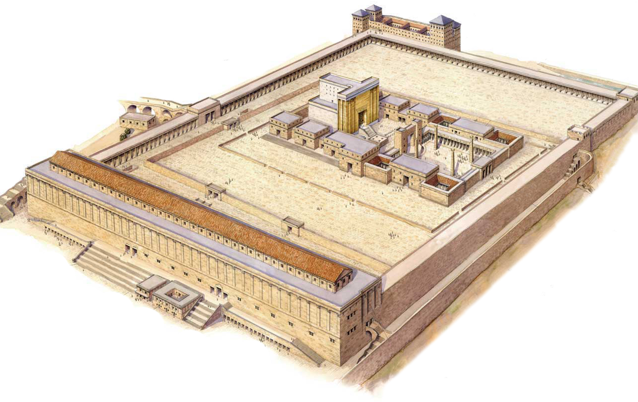
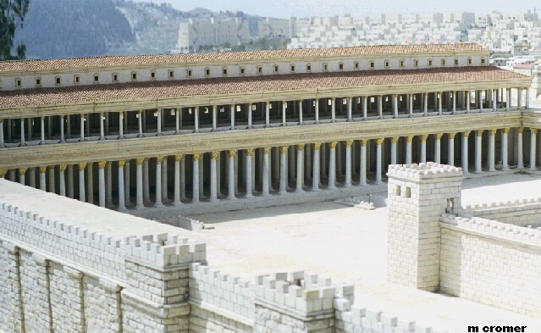
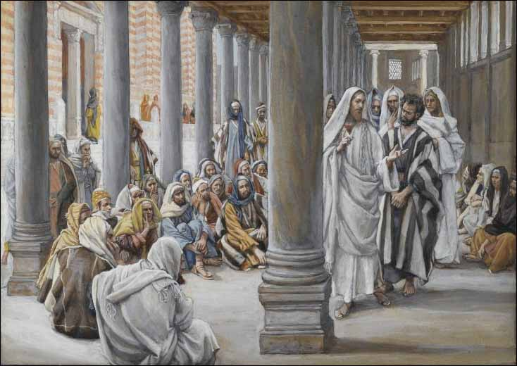
The Temple
Stairs to castle of Antonia
Court of the Gentiles
Solomon’s porch
Wall of partition separating Gentiles

Slide 6
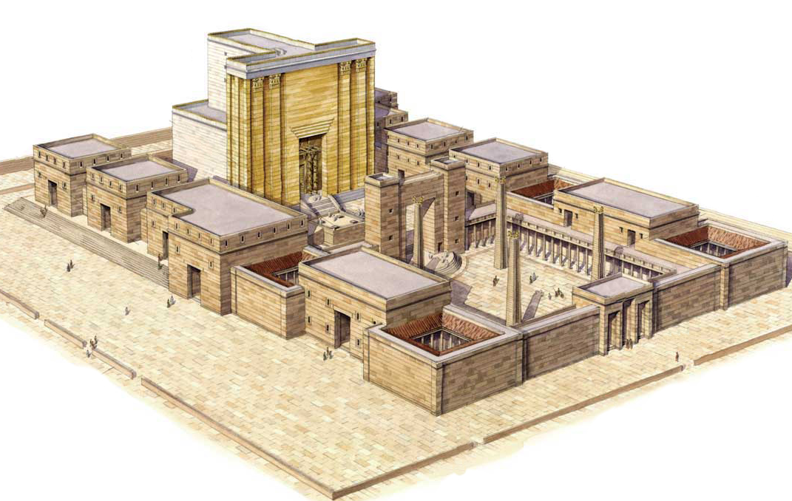
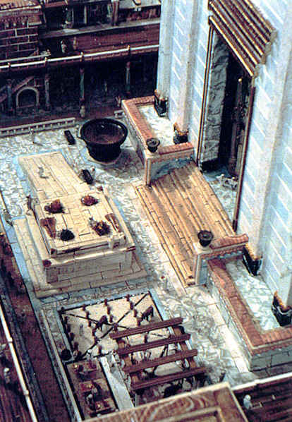
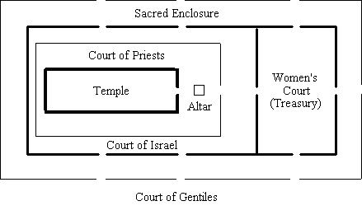
The Temple
Court of the Gentiles
Court of the Priests
Court of Israel
Beautiful Gate
Court of the Women
(“the treasury”)

Slide 7
The Temple
Court of the Gentiles
The Sanctuary
(House of God)
Apartments for priests

Slide 8
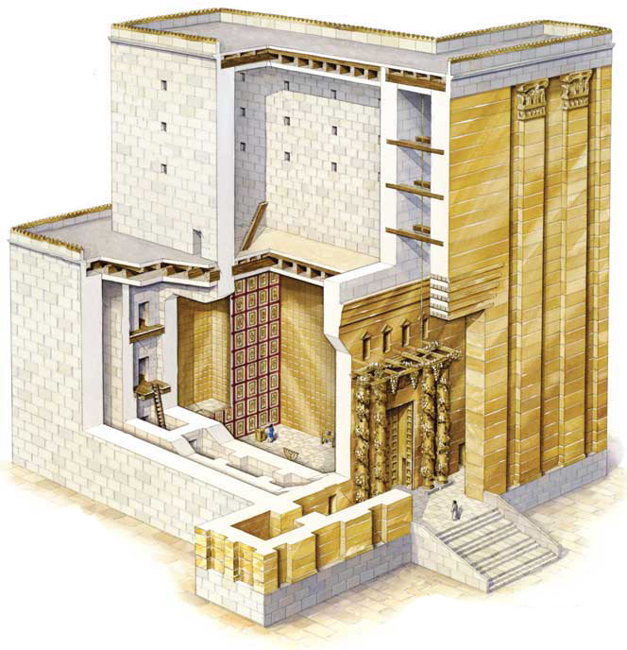
The Temple
The Holy of Holies
The Veil
The Holy Place

