Slide 1
Lesson 1:
The Land of Jesus
From Wayne Jackson’s book

Slide 2
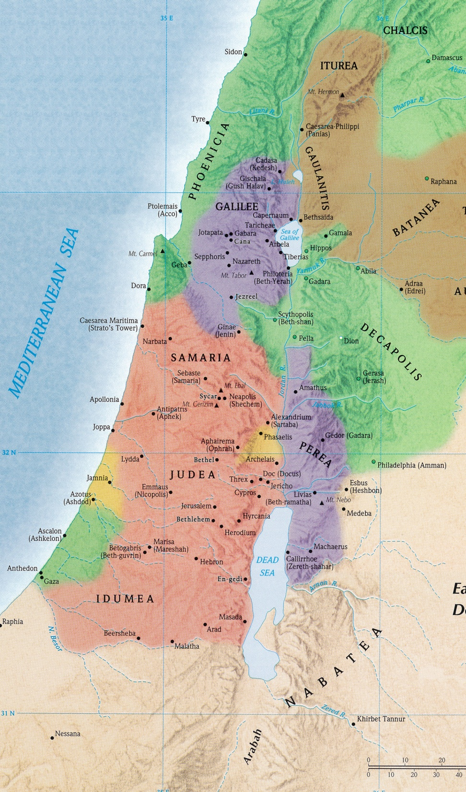
The Land of Jesus
The uniqueness of Palestine
Isolated by natural barriers from its regional neighbors
N – Lebanon mountains
E&S – Arabian & Nabatean deserts
W – Mediterranean Sea
Connected trades routes from Europe, Asia Minor & the East with Egypt
Travelers were touched by Israel’s concept of the true God
Lush productivity of the land allowed Jews more time for development of the unique elements of their religion
Great variety of geographical features and its plants, animals, etc. made it ideal place for writing Scripture

Slide 3
The Land of Jesus
Various Designations in Scripture
The Land of Canaan (Gen. 10:15)
The Land of Israel (Matt. 2:20)
The Land of Jehovah (Deut. 30:20)
The Land of Promise (Heb. 11:9)
The Holy Land (Zech. 2:12)
Palestine (Ex. 15:14)

Slide 4
The Land of Jesus
The Size of the Land
About 150 miles north to south
About 50 miles on average east to west
Smaller than the state of Massachusetts
Including the land of 12 tribes east of Jordan, it’s about 80 miles wide (about size of Massachusetts & Connecticut combined)
Solomon’s empire (the “Land of Promise”) spanned from the river of Egypt to the Euphrates (1 Kings 4:21)

Slide 5
The Land of Jesus
The Natural Divisions of the Land
The Maritime Plains
Phoenicia, the Plain of Sharon and Philistia down to Gaza
The Western Highlands
Mountains and hills from Upper Galilee south to Arabian Desert
The Jordan Valley
Drops in elevation drastically from north to south
1,700 ft above at source
1,300 ft below at Dead Sea
The Eastern Tableland
Lofty plateau east of Jordan River
Avg. elevation is higher than region west of river, with mtns & cliffs
Composed of Bashan, Bilead, Moab

Slide 6
The Land of Jesus
The Waters of the Land
The Mediterranean Sea
2,300 miles (E-S) x 1,200 miles (N-S)
The Jordan River
Winds 200 miles south (134 direct)
Avg. 80-180 ft wide, 5-12 ft deep
Drops some 3,000 feet in elevation
The Sea of Galilee
Chinnereth (Num. 23:11), Sea of Tiberias (John 6:1), Gennesaret (Luke 5:1), Sea of Galilee (Mt. 4:18)
13 miles (N-S) x 7 miles (E-W)
695 ft below sea level; 165 max depth
The Dead Sea
The Salt Sea (Gen. 14:3), The Eastern Sea (Ezek. 47:18), The Sea of Arabah (Deut. 3:17)
Lowest body of water on earth (1,296 ft below sea level; 1,300 ft max depth)
48 miles (N-S) x 6-9 miles (E-W)

Slide 7
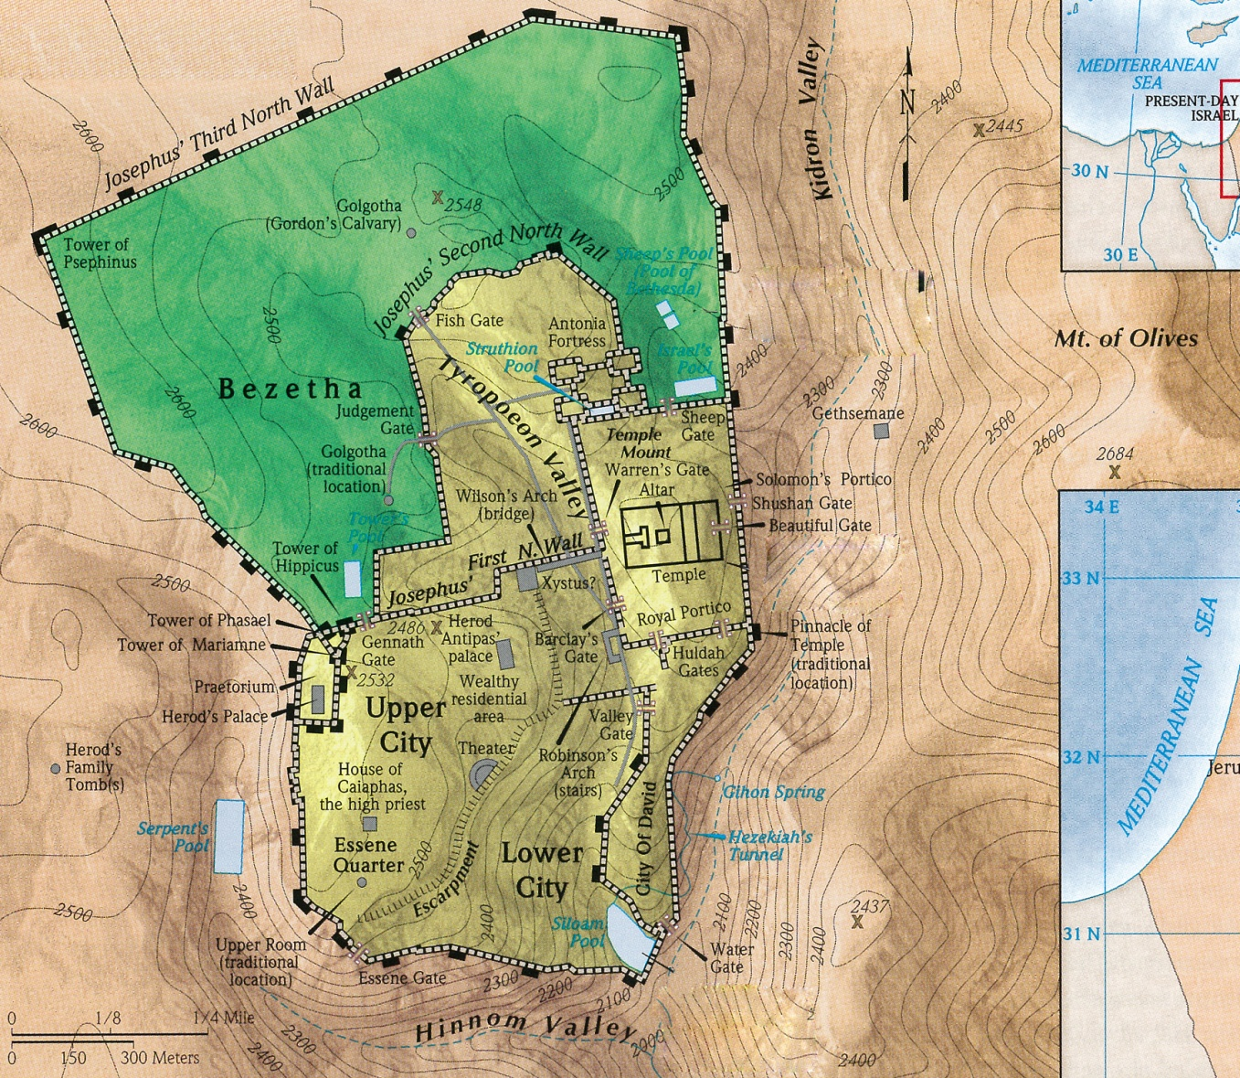
The Land of Jesus
The Waters of the Land
Several important streams
The Brook Kidron separates the eastern sector of Jerusalem from the Mount of Olives

Slide 8
The Land of Jesus
Prominent Mountains in Palestine
Kurn Hattin (Wof Sea of Galilee; 1,200 ft)
Traditional site of Sermon on Mount
Mt. Carmel (1,732 ft high)
Elijah’s encounter with Baal
Mtns Ebal (3,084 ft) & Gerizim (2,890 ft)
In Samaria, cursings and blessings
Mt. Moriah in Jerusalem (2,450 ft)
Site of Abraham’s sacrifice of Isaac
Mt. of Olives (2,665 ft)
Across Kidron, Jesus preached Mt 24
Mt. Zion in Jerusalem (2,550 ft)
Location of David’s castle
Mt. Hermon (9,232 ft)
North-most point Israel’s conquests
Mt. Nebo (2,631 ft)
12 miles east of north end of Dead Sea
Moses viewed promised land and died

Slide 9
The Land of Jesus
Cities of the Land (along Mediterranean)
Gaza
Most southern of 5 Philistine cities
Samson once carried off its gates
Joppa
45 miles up coast from Gaza
Simon the tanner lived there
Caesarea
23 miles S of Carmel (65 from Jeru)
Home of Cornelius
Tyre & Sidon
Phoenician coastal cities
Jesus once visited this region

Slide 10
The Land of Jesus
Cities of the Land (in Western Highlands)
Hebron
19 miles SSW of Jerusalem
Abram’s home near & buried there
Bethlehem
5 miles south of Jerusalem
Birthplace of Jesus
Jerusalem
20 miles W of north end of Dead Sea
David’s capital city
Bethel
11 miles north of Jerusalem
Jeroboam set up a golden calf

Slide 11
The Land of Jesus
Cities of the Land (in Western Highlands)
Sycar
Small village on main Samarian road
Near Gerizim, ½ mile N Jacob’s well
Samaria
Capital city of northern kingdom
42 miles N or Jerusalem
Nazareth
18 miles W south end of Sea Galilee
88 miles N of Jerusalem
Boyhood home of Jesus
Caesarea-Philippi
At the base of Mt. Hermon
120 miles N of Jerusalem
Jesus talked about the church

Slide 12
The Land of Jesus
Cities of the Land (in the Jordan Valley)
Sodom & Gomorrah
Destroyed for vile wickedness
Believed to be south end Dead Sea
En-gedi
West shore of Dead Sea (midway)
Where David hid from Saul
Qumran community
Less than mile NW corner Dead Sea
Where Dead Sea Scrolls discovered
Jericho
5 miles from N end of Dead Sea
5 miles west of Jordan River
17 NW of Jerusalem
3,200 feet below Jerusalem

Slide 13
The Land of Jesus
Cities of the Land (in the Jordan Valley)
Capernaum
NW coast of Sea of Galilee
Jesus’ center for Galilean ministry
Bethsaida
N shore of the Sea of Galilee
Home of Peter, Andrew & Philip
Gadara (country of Gadarenes)
Probably 5 miles SE of Sea of Galilee
Jesus healed two demoniacs

Slide 14
The Land of Jesus
How the Land Enhances the Book
Elijah defeated Baal on Mt. Carmel
Told Ahab to leave before the rain
Ahab took chariot to Jezreel
Elijah ran ahead of Ahab (1 K. 18:46)
Jezreel 16 miles from Mt. Carmel
Elijah fled from Jezebel
From Jezreel to Beersheba
90 miles straight; 150 miles winding
From Beersheba, went another day
Pushed south 200 miles to Sinai
Elijah gravely feared Jezebel

Slide 15
The Land of Jesus
How the Land Enhances the Book
Jonah fled from God and His commands
Lived in Gath-hepher (2 K. 14:25)
4 miles north of Nazareth
“Arise, go to Nineveh” (Jonah 1:2)
Capital of Assyria
Bank of Tigris, 500 miles east
Jonah went 50 miles SSW to Joppa
Took a ship bound to Tarshish
Phoenician colony in Spain
2,000 miles W of Palestine
“Farthest known city to the west”
Intended 2,500 miles from Nineveh

Slide 16
The Land of Jesus
How the Land Enhances the Book
Jesus heals a man in Capernaum
Jesus came to Cana (John 4:46ff)
9 miles N of Nazareth
Nobleman from Capernaum came
Son was “at the point of death”
Begged Jesus to “come down”
Jesus, “Go your way, your son lives.”
Arrived home
Son had been healed at exact time
Capernaum is 16 miles from Cana

Slide 17
The Land of Jesus
How the Land Enhances the Book
Conversion of Ethiopian treasurer
Ethiopian had traveled to Jerusalem, a difficult 200-mile journey
At same time, Philip was working in Samaria (Acts 8:5)
To Philip: “Go toward the south along road which goes down from Jerusalem to Gaza” (26) – 50 miles
Ethiopian was traveling the Jerusalem-Gaza road
Phillip intercepted the Ethiopian, taught him and baptized him

