Slide 1
Introduction

Slide 2
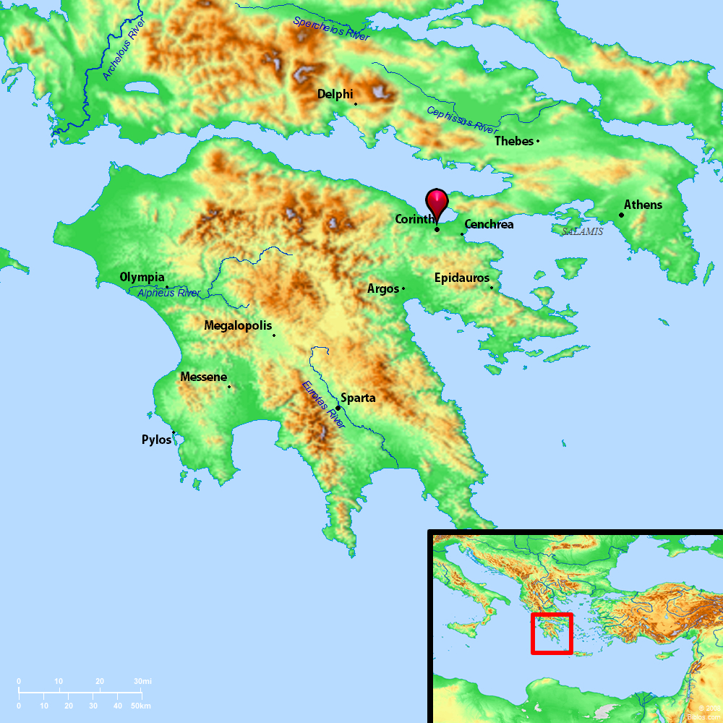
Understanding the City of Corinth
Strategic Location of the City
Located on the isthmus
Located on the major E-W trade route
One of the greatest trading &
commercial cities of the world

Slide 3
Understanding the City of Corinth
Population of the City
Highly transient population with the heavily trafficked ports.
Very mixed population: Roman soldiers, Greek & Roman citizens, merchants from around the world, many Jews, etc.

Slide 4
Understanding the City of Corinth
Spiritual Condition of the City
Widely known for its perverted idolatry, shameful immorality and abundant vices
Mixed populace from all over brought all their evils
“Corinthian” synonymous with a life of immorality, lust, debauchery, lasciviousness and reckless living.
Had the temple to the Greek goddess Aphrodite.
Aphrodite was the goddess of love.
The temple housed 1,000 “priestesses” (i.e., prostitutes) who performed the “religious services,” fulfilling the sexual pleasures of the male “worshipers.”

Slide 5
Understanding the City of Corinth
To understand 1 Corinthians, to understand the conditions of evangelizing in Corinth, to understand the struggles of the church in Corinth, need to know something of the city.
The location of the church (the city of Corinth) had a tremendous influence on the growth and development of the church.
What a testimony to the power of the gospel that it could triumph in such a wicked city!

Slide 6
Situation That Occasioned the Writing of the Letter
Paul worked in Ephesus for three years (20:31).
While in Ephesus, Paul began to receive troubling reports about the moral and spiritual condition of the church in Corinth.
The first word came via oral reports from those of Chloe’s household (1 Cor. 1:11), especially focusing on the division in the church.
The second word came via written questions to Paul from the church (1 Cor. 7:1).
One or both of these reports (the oral and the written) appears to have been delivered by Stephanas, Fortunatus and Achaicus (1 Cor. 16:17).

Slide 7
The Purpose of the Letter of 1 Corinthians
Paul’s main purposes in writing 1 Corinthians
To correct the errors being practiced and taught by the church in Corinth (chapters 1-6)
Responding to the report from Chloe’s household regarding division, arrogance, carnality, etc.
To answer the written questions the church had sent to him (Chapters 7-16)
Respond to the questions about marriage, meats, spiritual gifts, etc.
Each “now concerning” indicates a new question of theirs (cf. 7:1, 25; 8:1; 12:1; 16:1, 12).

Slide 8
Major Problems in the Church at Corinth
Division in the church
A party spirit, exalting preachers
Enamored by the wisdom of the world
Carnality among the members
Lack of growth
Sexual immorality
Lack of church discipline
Tolerating sin in the church
Going to law against a brother
Marriage problems
Confusion over marriage and divorce issues
Eating meats offered to idols
Sinning against weaker brethren
Putting a stumbling block before brethren
Lusting after evils things
Murmuring against God
The woman’s covering and being holy
Perversion of the Lord’s Supper
Irregularities and disorder in public worship
Improper role of women in the church
Contention over and abuses of spiritual gifts
Creating confusion in the church
Mistaken view of the resurrection
Misunderstanding about the collection
There are some things that have not changed in the church!

Slide 9
Solution to All Major Problems in the Church
The solution to problems in an individual Christian’s life and problems in a local church is found in the second verse of the book – 1 Cor. 1:2.

Slide 10
Solution to All Major Problems in the Church
“The church of God which is at Corinth”
“Those who are sanctified in Christ Jesus, called to be saints”
“Call on the name of Jesus Christ our Lord”

Slide 11
Solution to All Major Problems in the Church
The theme of 1 Corinthians summarized in these words: Jesus Christ Is Lord!
The word “Lord” is found 6 times in first 10 verses (v. 2, 3, 7, 8, 9, 10).
Found 70 times in the entire book.
When Jesus Christ is Lord of the life of a Christian and an entire congregation, living a holy, sanctified, set apart life will not be a burdensome chore but a joyous endeavor!

