Slide 1
Introduction

Slide 2
Understanding the City of Corinth
History of the City
Rome had destroyed the ancient city in 146 B.C.
Julius Caesar rebuilt it in 46 B.C.
Corinth was made a Roman Colony
It was the capital city of Achaia.

Slide 3
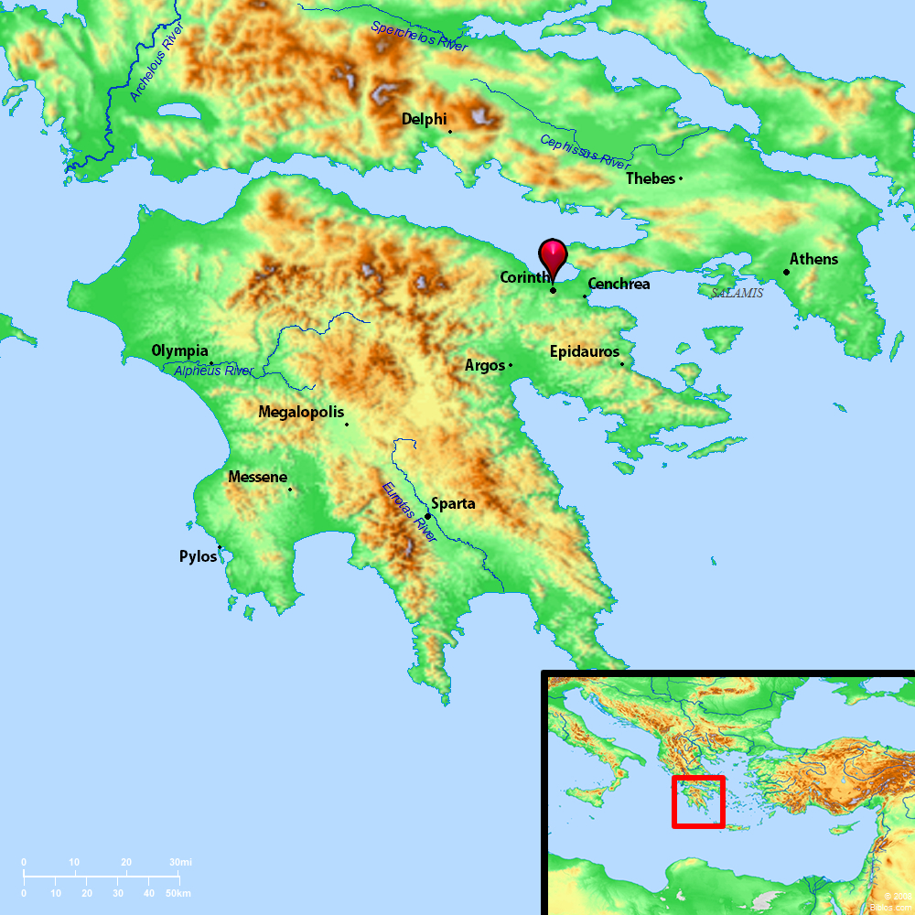
Understanding the City of Corinth
Strategic Location of the City
Located on the isthmus
Located on the major E-W trade route
One of the greatest trading &
commercial cities of the world

Slide 4
Understanding the City of Corinth
Business of the City
Center for manufacturing, mining and crafts
One of three major Grecian banking centers
Thriving, prosperous center for travel and trade

Slide 5
Understanding the City of Corinth
Population of the City
Highly transient population with the heavily trafficked ports.
Very mixed population: Roman soldiers, Greek & Roman citizens, merchants from around the world, many Jews, etc.
Around the time of Paul, it is estimated the population was about 500,000.

Slide 6
Understanding the City of Corinth
Spiritual Condition of the City
Widely known for its perverted idolatry, shameful immorality and abundant vices
Mixed populace from all over brought all their evils
“Corinthian” synonymous with a life of immorality, lust, debauchery, lasciviousness and reckless living.
Had the temple to the Greek goddess Aphrodite.
Aphrodite was the goddess of love.
The temple housed 1,000 “priestesses” (i.e., prostitutes) who performed the “religious services,” fulfilling the sexual pleasures of the male “worshipers.”

Slide 7
Understanding the City of Corinth
To understand 1 Corinthians, to understand the conditions of evangelizing in Corinth, to understand the struggles of the church in Corinth, need to know something of the city.
The location of the church (the city of Corinth) had a tremendous influence on the growth and development of the church.
What a testimony to the power of the gospel that it could triumph in such a wicked city!

Slide 8
Establishment of the Church in Corinth
‒ Acts 18
Paul first came to Corinth on his second missionary journey (50 A.D.).
He left Macedonia in a time of peril (17:13-15).
He waited for Silas & Timothy in Athens, to hear the condition of church in Macedonia (17:14-15).
When Silas & Timothy did not come, he went to Corinth, where they later met him (Acts 18:5).

Slide 9
Establishment of the Church in Corinth
‒ Acts 18
Paul labored in Corinth for 18 months (18:11).
He joined with Aquila & Priscilla in making tents (Acts 18:2-3).
He reasoned in the synagogue every Sabbath, persuading both Jews & Greeks (Acts 18:4).
He converted many to Christ:
Crispus, the ruler of the synagogue (Acts 18:8)
Sosthenes (Acts 18:17; 1 Cor. 1:1)
Gaius (1 Cor. 1:14; Acts 18:7)
Household of Stephanas (1 Cor. 1:16; 16:15)

Slide 10
Establishment of the Church in Corinth
‒ Acts 18
Paul labored in Corinth for 18 months (18:11).
He was brought to trial by the Jews before Gallio (Acts 18:12-16).
Gallio was the proconsul/senatorial leader/governor.
Gallio quickly dismissed the case against Paul.
Gallio’s verdict opened doors for Paul to preach the gospel all over the Roman Empire.
Interesting that the Lord had told Paul in a vision, “I am with you, and no one will attack you to hurt you; for I have many people in this city” (Acts 18:10).
The providence of God was at work, even using Gallio for His purposes.

Slide 11
Establishment of the Church in Corinth
‒ Acts 18
Paul left Corinth in early 52 A.D. to return to Antioch (Acts 18:18-22).
The church was made up of Jews and primarily Gentiles (cf. 1 Cor. 12:2).
After Paul left Corinth, Apollos came and “greatly helped those who had believed through grace” (Acts 18:27).
Paul visited again on his third missionary journey (Acts 20:1-2), and intended to make a third visit (2 Cor. 12:14; 13:1-2).

Slide 12
Situation That Occasioned the Writing of the Letter
Paul worked in Ephesus for three years (20:31).
While in Ephesus, Paul began to receive troubling reports about the moral and spiritual condition of the church in Corinth.
The first word came via oral reports from those of Chloe’s household (1 Cor. 1:11), especially focusing on the division in the church.
The second word came via written questions to Paul from the church (1 Cor. 7:1).
One or both of these reports (the oral and the written) appears to have been delivered by Stephanas, Fortunatus and Achaicus (1 Cor. 16:17).

Slide 13
Situation That Occasioned the Writing of the Letter
So, Paul writes our 1 Corinthians in 55 A.D. from Ephesus (1 Cor. 16:8).
Paul wrote of those matters that were the most urgent (1 Cor. 11:34).
He sent Timothy to remind them of his ways in Christ (1 Cor. 4:14-17). The letter would arrive before Timothy.
Paul planned to personally visit shortly to set the rest in order (1 Cor. 4:19, 21; 11:34; 16:2-5).

Slide 14
The Purpose of the Letter of 1 Corinthians
Part of a series of letters to the church in Corinth
He wrote an initial letter we no longer have (1 Cor. 5:9).
He wrote this letter (1 Corinthians).
He would later (about a year later) write 2 Corinthians.
Part of a series of letters often called “The Salvation Epistles”
This includes Romans, 1 & 2 Corinthians and Galatians.
All written around the same time, while Paul was on his third missionary journey (55-56 A.D.).
Each of these epistles emphasizes the doctrine of salvation (cf. Rom. 1:16).

Slide 15
The Purpose of the Letter of 1 Corinthians
Paul’s main purposes in writing 1 Corinthians
To correct the errors being practiced and taught by the church in Corinth (chapters 1-6)
Responding to the report from Chloe’s household regarding division, arrogance, carnality, etc.
To answer the written questions the church had sent to him (Chapters 7-16)
Respond to the questions about marriage, meats, spiritual gifts, etc.
Each “now concerning” indicates a new question of theirs (cf. 7:1, 25; 8:1; 12:1; 16:1, 12).

Slide 16
Major Problems in the Church at Corinth
Division in the church
A party spirit, exalting preachers
Enamored by the wisdom of the world
Carnality among the members
Lack of growth
Sexual immorality
Lack of church discipline
Tolerating sin in the church
Going to law against a brother
Marriage problems
Confusion over marriage and divorce issues
Eating meats offered to idols
Sinning against weaker brethren
Putting a stumbling block before brethren
Lusting after evils things
Murmuring against God
The woman’s covering and being holy
Perversion of the Lord’s Supper
Irregularities and disorder in public worship
Improper role of women in the church
Contention over and abuses of spiritual gifts
Creating confusion in the church
Mistaken view of the resurrection
Misunderstanding about the collection
There are some things that have not changed in the church!

Slide 17
Solution to All Major Problems in the Church
The solution to problems in an individual Christian’s life and problems in a local church is found in the second verse of the book – 1 Cor. 1:2.

Slide 18
Solution to All Major Problems in the Church
“The church of God which is at Corinth”
The church is a community of people governed by the will of God (cf. 1 Cor. 1:1).
The city of Corinth was a community of people governed by sinful passion & lusts.
Yet, THE CHURCH was in/at CORINTH.
The church must learn to be IN the world but not OF the world (cf. John 17:14-16).
The city of Corinth had invaded and spread within the church, rather than the church invading and spreading within the city of Corinth.

Slide 19
Solution to All Major Problems in the Church
“Those who are sanctified in Christ Jesus, called to be saints”
Sanctified = verb, meaning to make holy, set apart
Saint = noun, meaning a holy one, set apart
Those who are holy/sanctified/set apart are those who are “in Christ.”
Those who are in Christ are to be different than those who are in the world!

Slide 20
Solution to All Major Problems in the Church
“Call on the name of Jesus Christ our Lord”
When Christians…
acknowledge Jesus Christ as LORD of their lives…
live and work under the LORDSHIP of Jesus Christ…
honor Jesus Christ as LORD of all things in their lives…
submit to the authority of Jesus Christ as LORD…
When the church…
acknowledges Jesus Christ as LORD of the church…
lives and works under the LORDSHIP of Jesus Christ…
honors Jesus Christ as LORD of all things it says and does…
submits to the authority of Jesus Christ as LORD…
Then, all problems caused by selfish and ignorant pride will be resolved!

Slide 21
Solution to All Major Problems in the Church
The theme of 1 Corinthians summarized in these words: Jesus Christ Is Lord!
The word “Lord” is found 6 times in first 10 verses (v. 2, 3, 7, 8, 9, 10).
Found 70 times in the entire book.
When Jesus Christ is Lord of the life of a Christian and an entire congregation, living a holy, sanctified, set apart life will not be a burdensome chore but a joyous endeavor!

