Slide 1
Lesson 7:
Conclusion & Our Proper Response

Slide 2
What This Class Is NOT Intended to Do
Not to be unkind
Not to present a haughty, un-Christlike spirit
Not to attack Community Churches (in general)
Not to attack a particular Community Church
Not to treat them unjustly in any way
Not to misrepresent them in any way
Not to ridicule or belittle any person or organization
Not to say, “We’re so much better than you”

Slide 3
What This Class Is Intended to Do
To follow the soul-saving instructions of the Lord:
“Beloved, do not believe every spirit, but test the spirits, whether they are of God…” (1 John 4:1; cf. 1 Thess. 5:21)
To follow the highly-praised example of the Bereans:
“…They received the word with all readiness, and searched the Scriptures daily to find out whether these things were so” (Acts 17:11).
To fairly examine the teachings of a popular religious movement in light of the teachings of Scripture, by presenting their teachings in their own words and comparing them with God’s teachings in His own Words
Psa. 119:105, 130; John 3:19-21; 2 Cor. 4:4-6; Eph. 5:13; 2 Pet. 1:19
To examine whether we are in “the faith”/“the truth” (2 Cor. 13:5-7), as there is only “one faith” (Eph. 4:4-6)
To sharpen our knowledge, inform our hearts and fortify our faith in the faith of the gospel (2 Pet. 3:15; Jude 3; Prov. 3:5-6)

Slide 4
Would you agree with this?
“Left to ourselves, we corrupt virtually everything we touch, even the clear message of the Bible. This tendency to twist and misinterpret God’s revelation is recorded in the very history of God’s people and it remains a common occurrence in daily life:
“Israel continually deviated from the covenant stipulations of God despite the fact that God repeated them over and over.
“The New Testament community had false prophets attempt to infiltrate its ranks and subvert the Gospel message.
“The Early Church saw its doctrinal purity tainted soon after the Apostles had died.

Slide 5
Would you agree with this?
“It is quite common for individuals to pick and choose what they approve in God’s word and discard the rest. It is common practice to substitute the truth as taught by the Apostles with purely human traditions, substituting God’s Word with error-laden religious rituals….
“...Why are there so many religions? These are man-made attempts to re-connect with God on human terms while rejecting God’s terms.
“There are lots of religions, philosophies, and ideas out there. They all claim to reflect reality and truth. The exclusive claims of the Bible are not popular with many people, yet it is clear that any belief that is not supported by Scripture is false and must be rejected. All other views and religions are in error. Only the biblical [view] reflects the reality of the Creator’s perspective, the way things really are.”

Slide 6
Summary: What Community Churches Teach About Their Origins
Community churches have been designed “to appeal to [and to give] the unchurched what [they] were looking for” (Purpose Driven, p. 193)
“The theology and doctrine of community churches and mega-churches varies according to the beliefs of the pastor” (2010 Handbook of Denominations, p. 274).
“God spoke personally to me” (Purpose Driven, p. 26).

Slide 7
Summary: What Community Churches Teach About Salvation
“Pray to receive Jesus; ask Jesus to forgive you for your wrongs” (http://media.willowcreek.org/).
“We believe that salvation is by faith alone” (from Christ Fellowship online video, “We Believe”).
“You can receive Christ now by asking God to forgive you and by inviting Christ to be Lord (CEO) of your life…The following is a suggested prayer…” (http://gochrist fellowship.com/about-us/new-here/need-a-change).

Slide 8
Summary: What Community Churches Teach About Salvation
“…No one is condemned to Hell because they never heard the Gospel…the Bible implies that humans will be judged according to the amount of information they had about God, not according to the revelation they did not receive” (http://gochristfellowship.com/).
“…Every human being is born a sinner, with deep-seated inclinations to revolt against God’s righteous rule…Everyone, including babies, is born in sin (Psalm 51:5; 58:3)” (http://gochristfellowship.com/).

Slide 9
Summary: What Community Churches Teach About Baptism
“Baptism is an outward sign of an inward commitment you made in your heart to Jesus” (www.iamelevate.com).
“Baptism doesn’t ‘save’ you from your sins” (www.iamelevate.com).
“Baptism does not provide salvation for an individual” (http://www.willowcreek.org/).
“Baptism isn't a prerequisite for salvation” (http://www.willowcreek.org/).
“Baptism was never intended to provide salvation” (http://www.willowcreek.org/).

Slide 10
Summary: What Community Churches Teach About Baptism
“Baptism does not save you, but shows the world that you have already been saved. And while baptism is not required for salvation” (http://www.saddleback.com/).
“Baptism does not ‘save’ you” (http://www.saddleback.com/).
“The act of baptism does not in itself save a person” (Christ Fellowship “Baptism” video, “Conversation 1”).
“Baptism does not save you…You can be a Christian without being baptized…” (Christ Fellowship “Baptism Orientation Video”).

Slide 11
Summary: What Community Churches Teach About Baptism
“It is important to note that the Bible does not teach that baptism is necessary for salvation. A person is not saved because he or she is baptized. The thief on the cross next to Jesus was told he would be in paradise that day, yet he was not baptized” (http://gochristfellowship.com).
“Baptism celebrations occur monthly…In order to make the Baptism celebration more personal, we will accept the first 40 people to register per month” (http://www.willowcreek.org/baptism/).
“Unless there are severe weather warnings, Baptism will occur rain or shine!” (http://www.saddleback.com/).

Slide 12
Summary: What Community Churches Teach About Baptism
“Upcoming Beach Baptisms: October through April baptisms will be weather dependent” (http://gochristfellowship.com/events/baptism/).
“Baptism happens the fourth weekend of almost every month at Christ Fellowship. You can schedule to be one of those who is baptized during one of our services or you can baptized at the beach during the summer…” (Christ Fellowship “Baptism Orientation Video”).
“Some individuals may request Baptism by the sprinkling of water rather than full immersion…Willow Creek offers the option of believers’ baptism in the modes of sprinkling and immersion” (http://www.willowcreek.org/).

Slide 13
Summary: What Community Churches Teach About Evangelism & Worship
“If it takes rock music to get [young adults] to the church, then amen to that” (Christ Fellowship PB Post article).
“These changes have produced a generation that expects to be offered options in every area…It is not pandering to consumerism to offer multiple services or multiple styles of worship. It is strategic and unselfish, and it says we will do whatever it takes to reach more people for Christ” (Purpose Driven, p. 200).

Slide 14
Summary: What Community Churches Teach About Worship
“There is no correct ‘style’ of worship…I don’t think God is offended or even bothered by different styles of worship…In fact, I’m certain that God enjoys the variety! …The truth is, there isn’t a biblical style of worship” (Purpose Driven, p. 240-241).
“What is most important is that God does not prescribe the form of our worship” (http://gochristfellowship.com/).

Slide 15
Summary: What Community Churches Teach About Worship
“1995: The growing congregation runs out of space and expands to create the area of the sanctuary known as ‘Samaria.’ Even with the additional space, more Sunday morning services and a Saturday evening service are added.”
Actual Screenshot on November 9, 2010 from http://gochristfellowship.com/ fileadmin/Life_Groups/25th_Anniv/CF_25_Years_of_Impact_magazine_for_web.pdf

Slide 16
Summary: What Community Churches Teach About The Lord’s Supper
“Believers are to participate in observing the Lord’s Supper on a regular basis. While some churches observe it every Lord’s Day and others only once a month or once a quarter, it is quite clear that the Lord’s Supper is to be observed on a perpetual basis until Jesus returns.”
Actual Screenshot on November 9, 2010 from http://gochristfellowship.com/ grow-deep/spiritual-questions/church/what-is-the-lords-supper-or-communion/

Slide 17
Summary: What Community Churches Teach About The Lord’s Supper
“We offer Communion at least 1 time per month in all of our services. We are actually serving Communion this weekend (November 16 and 17).”
Actual Screenshot on November 10, 2010 of email reply to me from CF.

Slide 18
Summary: What Community Churches Teach About Falling from Grace
Actual Screenshot on November 9, 2010 from http://gochristfellowship.com/grow-deep/spiritual-questions/salvation/cana-christian-lose-hisher-salvation/

Slide 19
Summary: What Community Churches Teach About Falling from Grace
Christians “may experience failure and even backsliding for a season, but if their faith is genuine, they will return to a pattern of obedient service, living out their true calling as God’s children. Someone who is truly saved cannot lose their salvation (John 10:27-30; Romans 8:1; Romans 8:35-39; John 5:24; 1 John 5:13; Titus 3:7; 1 John 1:8-9).”
November 9, 2010 from http://gochristfellowship.com/grow-deep/spiritual-questions/salvation/cana-christian-lose-hisher-salvation/

Slide 20
The Teachings of Scripture on Falling from Grace
God plainly proclaims and clearly warns that a Christian can fall away and lose his salvation:
Scriptures include Acts 8:22; 20:29-30; Rom. 6:12-13, 18; 11:21-22; 14:12; 1 Cor. 6:9; 10:12; 15:58; 2 Cor. 5:11; Gal. 1:6-9; 3:1; 5:1, 4, 7, 21; 6:1; Eph. 5:5-6, 10-11; Col. 3:6, 25; 1 Thess. 3:5; 2 Thess. 1:7-9; 1 Tim. 4:1; Heb. 2:1; 3:8-14; 4:1, 11; 6:4-6; 10:12-15, 26-27, 30-31, 36; 12:29; James 2:17, 20, 26; 4:4; 5:19-20; 1 Pet. 2:11; 2 Pet. 1:10; 2:18-22; 1 John 1:7; 2:15-17; Rev. 2:5, 10, 16; 3:3, 19

Slide 21
Summary: What Community Churches Teach About Church Organization
We arrived at Saddleback Valley. I…stopped at the first real estate office I could find. I walked in and introduced myself to the first realtor I met. His name was Don Dale…While driving to the condo, I asked Don if he attended church anywhere. He said he didn’t. I replied, “Great! You’re my first member!”… I began Saddleback Church with that realtor’s family… (Purpose Driven, 36-37)
Even though our staff is… I require each of them to… (p. 57)
I want prospective members to make sure they know exactly where Saddleback Church is headed…before they join. (p. 91)

Slide 22
Summary: What Community Churches Teach About Church Organization
I instituted… I repeatedly challenged… I taught them… I preached… I taught… I began to give greater emphasis… I stressed… I added staff to assist me…(p. 140)
I’m having to add younger staff… (p. 177)
I told the whole congregation, “I release all of you to visit…and you don’t even have to tell me.” (p. 386)
My greatest source of learning, however, has been watching what God has done in the church I pastor. (p. 18)
The pastor of the church sets the tone and atmosphere of the congregation. (p. 212)

Slide 23
Summary: What Community Churches Teach About Church Organization
Throughout the New Testament, principles of church leadership point to a central theme: plurality. The church is to be led by a plurality of godly leaders. By relying on consensual agreement of godly Elders selected from the congregation, the church creates a healthy checks-and-balances of leadership direction, financial accountability, spiritual guidance, and ministry implementation.
Willow Creek implements these biblical principles in its leadership structure. A strategy of biblically based policies and guidelines within its Elder board and ministry leaders guides ministry decisions and ensure that a healthy, God-honoring implementation of leadership and pastoral care is carried out. Willow has been blessed by more than three decades of impeccable, godly leadership from an Elder board whose heart beats for the kingdom of God as expressed through the local church. We look to the future with confidence, thanks to the servant leadership this team of seasoned Christ followers provides. (http://www.willowcreek.org/governance)

Slide 24
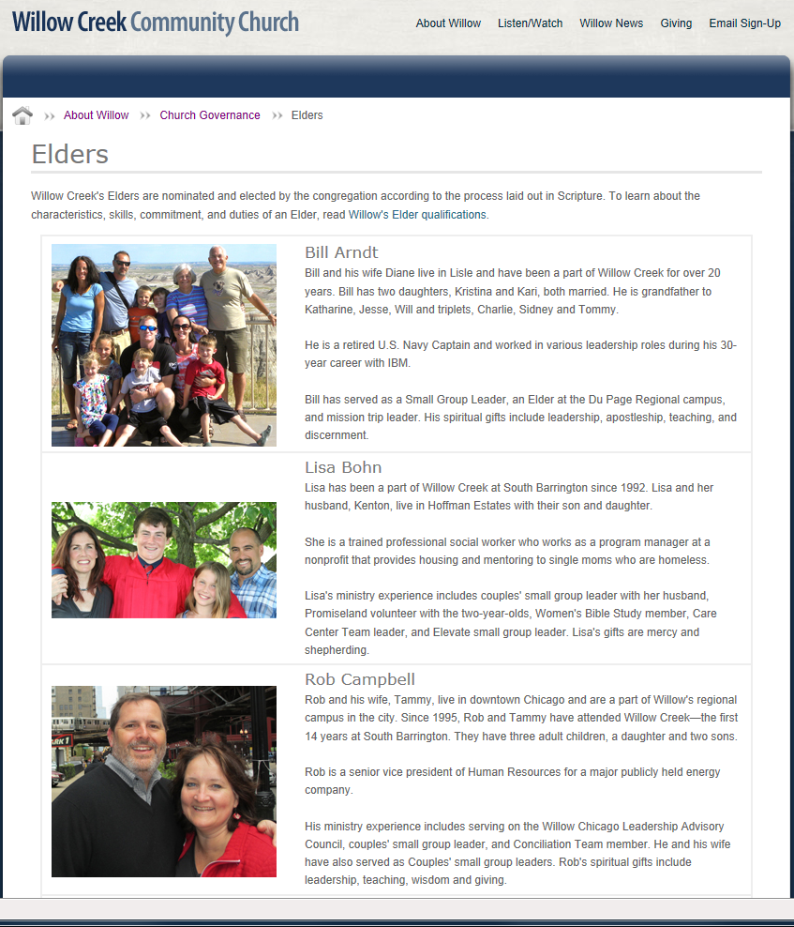
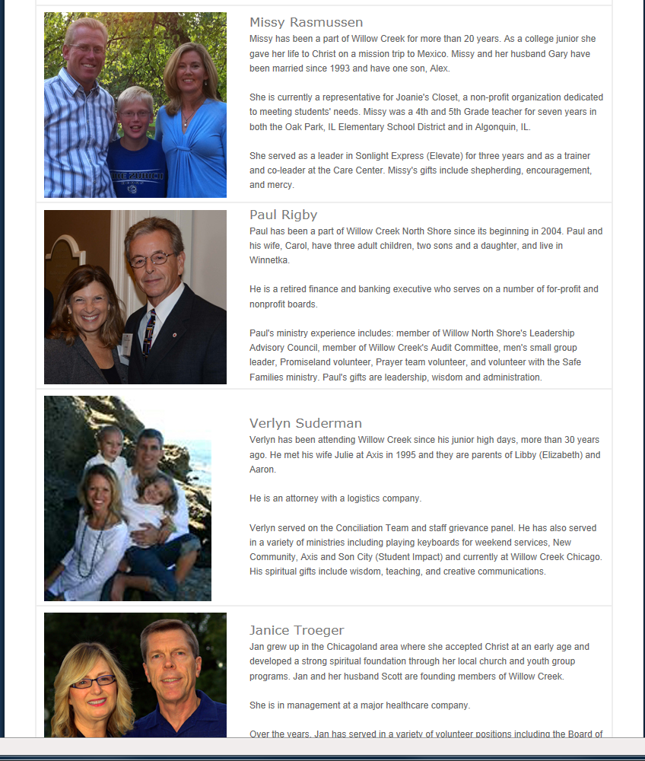
Summary: What Community Churches Teach About Church Organization

Slide 25
Summary: What Community Churches Teach About Church Organization
Anyone who is a member [at Willow Creek] adheres to the statement of beliefs and practices of the church…
Dick Carr had attended Willow Creek since 1992…That's why Mr. Carr's dissent over the women-in-leadership position is painful for him to talk about…When Mr. Carr decided to join the church, he ran into difficulties. An appendix of the membership book "threw up red flags for me."
Mr. Carr asked his division leader, who told him to read Dr. B's Beyond Sex Roles. That raised even more questions…Mr. Carr went back to his division leader, who referred him to a female elder who is the author of a paper called “Elders’ Response to the Most Frequently Asked Questions About Membership at Willow Creek.” In that document, volunteer membership coaches are told, “We ask that Participating Members of Willow Creek minimally be able to affirm and joyfully sit under the teaching of women teachers…that they can joyfully submit to the leadership of women in various leadership positions at Willow Creek.”
(http://www.wayoflife.org/fbns/fbns/fbns464.html)

Slide 26
The Teachings of Scripture on Church Organization
In the New Testament church:
Local congregations are self-governing and completely autonomous. There is only one head of the church and that is Christ (Col. 1:18).
Local congregations are overseen by a group of qualified men (always a plurality) from within that congregation called elders (1 Tim. 3:1-7; Acts 14:23).
The name “pastor” never referred to a preacher in the New Testament but always to an elder and always to more than one man in a congregation.
Local congregations that are served by a group of qualified men called deacons (1 Tim. 3:8-13; Phil. 1:1).
Local congregations that have the gospel proclaimed to them by evangelists (2 Tim. 4:5; Eph. 4:11).
Women are not permitted to be evangelists (1 Tim. 2:11) or elders (1 Tim. 3:2) but are encouraged to teach other women and children (Titus 2:3-4).

Slide 27
Would you agree with this?
“Left to ourselves, we corrupt virtually everything we touch, even the clear message of the Bible. This tendency to twist and misinterpret God’s revelation is recorded in the very history of God’s people and it remains a common occurrence in daily life:
“Israel continually deviated from the covenant stipulations of God despite the fact that God repeated them over and over.
“The New Testament community had false prophets attempt to infiltrate its ranks and subvert the Gospel message.
“The Early Church saw its doctrinal purity tainted soon after the Apostles had died.

Slide 28
Would you agree with this?
“It is quite common for individuals to pick and choose what they approve in God’s word and discard the rest. It is common practice to substitute the truth as taught by the Apostles with purely human traditions, substituting God’s Word with error-laden religious rituals….
“...Why are there so many religions? These are man-made attempts to re-connect with God on human terms while rejecting God’s terms.
“There are lots of religions, philosophies, and ideas out there. They all claim to reflect reality and truth. The exclusive claims of the Bible are not popular with many people, yet it is clear that any belief that is not supported by Scripture is false and must be rejected. All other views and religions are in error. Only the biblical [view] reflects the reality of the Creator’s perspective, the way things really are.”
November 9, 2010 from http://
gochristfellowship.com/grow-deep/spiritual-questions/salvation/what-happened-in-the-fall/

Slide 29
How Would God Have Me/Us Respond?
We must recognize that their doctrines and practices are NOT in harmony with God’s Word!
Based on all the evidence (presented and other unpre-sented), the Community Churches (incl. Christ Fellowship) are not “holding fast the pattern of sound words” (2 Tim. 1:13). They are not submitting to the authority of Christ (Col. 3:17) and are not doing the will of God, as detailed in the pages of the New Testament (Matt. 7:21).
In their own words, their teachings and practices, which are not supported by Scripture, are “false and must be rejected.” Please remember that this is not intended to be an attack, but an honest evaluation of their teachings in light of the teachings of Scripture. God said, “Do all in the name of the Lord Jesus” (Col. 3:17).

Slide 30
How Would God Have Me/Us Respond?
How can we reach them?
Go back to the Bible!
Demand Bible authority!
Ask: “Where is that in the Bible?”
Ask: “What verse teaches that?”
Reveal the Simplicity of N.T. Christianity
One God, One Book, One Religion, One Church, One Plan
Invite to Participate in the Beauty of N.T. Worship
Focus on Salvation As the Key Issue
Ask: “What must one do to be saved?”
Ask: “What does the Bible say?”
Show them God’s perfect plan of salvation in His Word.

Slide 31
How Would God Have Me/Us Respond?
We must exercise extreme caution!
While God has always had a pattern which He expected His faithful children to follow (Heb. 8:5; 2 Tim. 2:13) and obey (Heb. 5:8-9; Gal. 1:8-10; Acts 5:29), man has not always been satisfied to comply.
Even the Lord’s church has been threatened by man-made doctrines and practices.

Slide 32
How Would God Have Me/Us Respond?
The Community Church movement poses a real threat to churches of Christ!
Our society, we are told:
Is moving farther and farther away from being receptive to the Scriptures.
Is bored with the church, bored with worship, bored with doctrine, bored with preaching, bored with “stiff religion.”
The solution, we are told:
Is to discover the needs of the people we are trying to reach
Is to adjust our teaching and practice to meet those needs
Is to make changes to make the church more appealing and acceptable to the world
Is to study denominational growth methods and emulate their successes to glean greater numbers and dollars to keep things going for us

Slide 33
How Would God Have Me/Us Respond?
CONSTANTLY TEST teachers and teachings to see “whether they are of God” (1 John 4:1; cf. 1 Thess. 5:21-22).
“WATCH” and be aware of teachings and their devastating consequences if contrary to Scripture (Acts 20:31).
SEARCH THE SCRIPTURES daily to find out whether teachings and practices “are so” (Acts 17:11).
DO NOT BE CARRIED ABOUT by “every wind of doctrine” that comes along (Eph. 4:14; Heb. 13:9).
DO NOT BID THEM GOD SPEED (i.e., show approval or wish them well) in their endeavors (2 John 9-11).
HAVE NO FELLOWSHIP with them, participating or sharing in their activities or worship services (Eph. 5:11; cf. 1 Tim. 6:5).

Slide 34
How Would God Have Me/Us Respond?
EXPOSE THEM and their teachings with the light of the Word of God (Eph. 5:11-13; cf. John 3:20-21).
BE CAUTIOUS, lest you also share in their deeds (contrary to God’s will) and share in their doom (2 John 9-11; Gal. 1:8-9).
PRAY FOR THEM that they might find the truth, learn the truth, have hearts open to the truth and obey the truth (1 Tim. 2:1-6).
TEACH THEM God’s Word, teaching to observe all that Jesus (our Authority) has commanded (Matt. 28:18-20; Col. 1:28).
SEEK GOD’S TRUTH and His righteousness instead of man’s (Prov. 23:23; Matt. 6:33; John 8:32).
OBEY THE TRUTH and devote yourself to the teachings and practices of the New Testament (1 Pet. 1:22; Col. 3:17).

